Slide 1
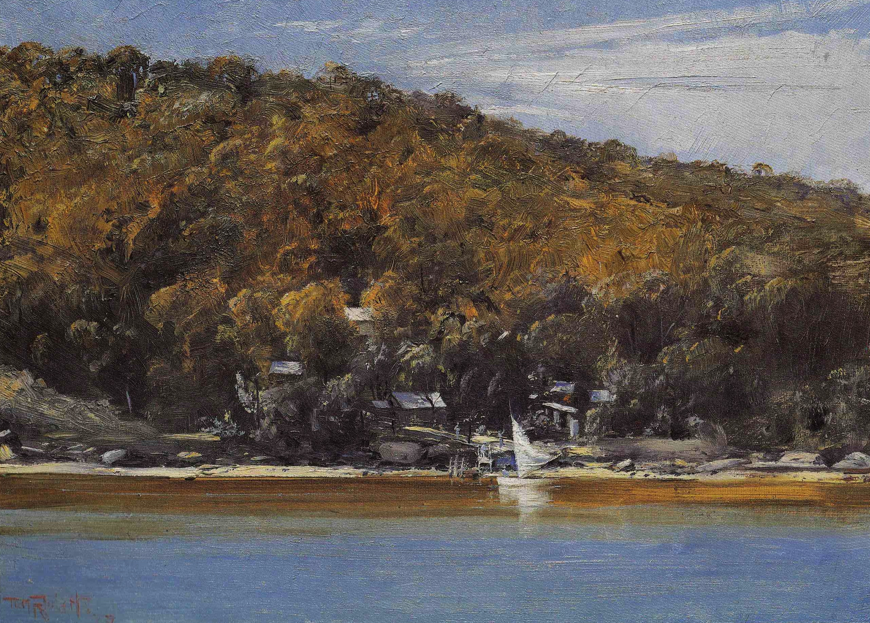
MOSMAN’S ARTISTS’ CAMPS
David Carment

Slide 2
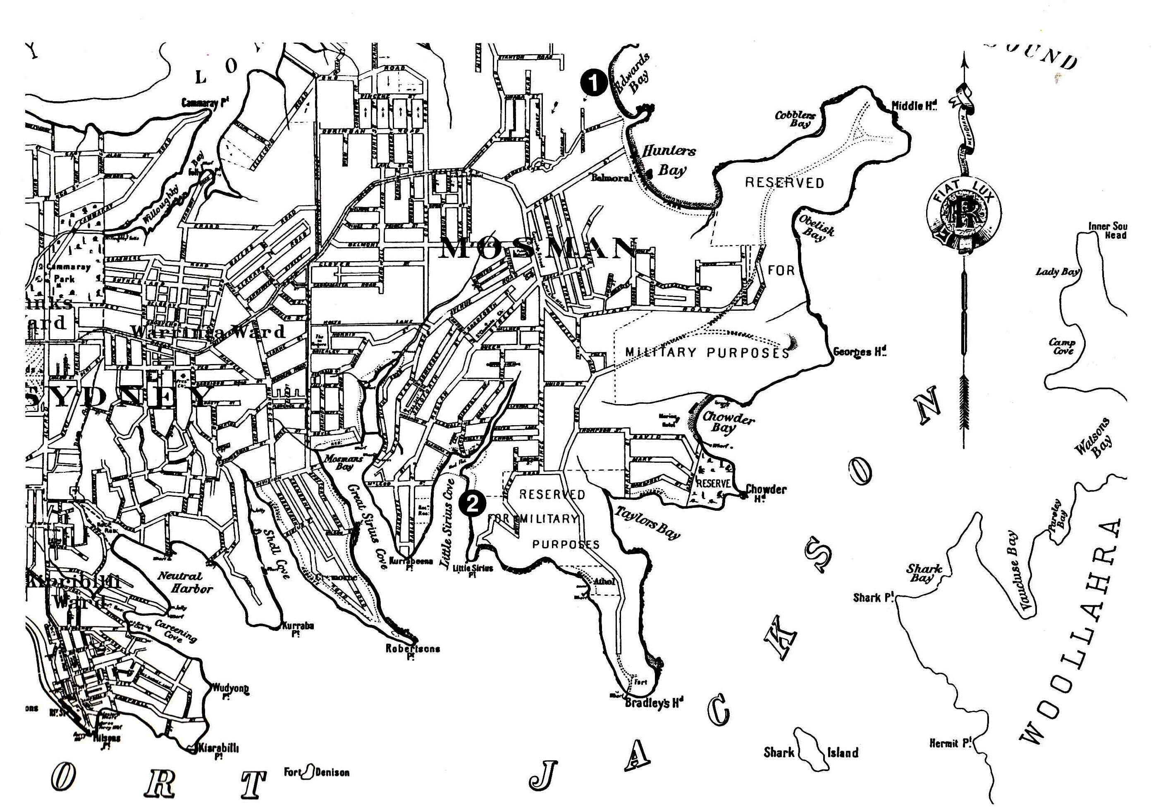
Mosman in 1893 showing the artists’ camps’ positions
(Albie Thoms et al, Bohemians in the Bush: The Artists’ Camps of Mosman, Art Gallery of New South Wales, Sydney, 1991)

Slide 3
Most artists at the Mosman camps belonged to the Heidelberg School. Greatly influenced by French impressionism, they painted in the open air (en plein air) to capture the Australian landscape’s light and colour.
Mosman artists’ camps provided retreats ‘from bourgeois urban existence’. They were places for ‘painting, swimming, fishing and conviviality’. The camps helped ensure that ‘Mosman may well have been painted more than any other Australian landscape’ (Gavin Souter, Time & Tides: A Middle Harbour Memoir, Simon & Schuster, Sydney, 2004).

Slide 4
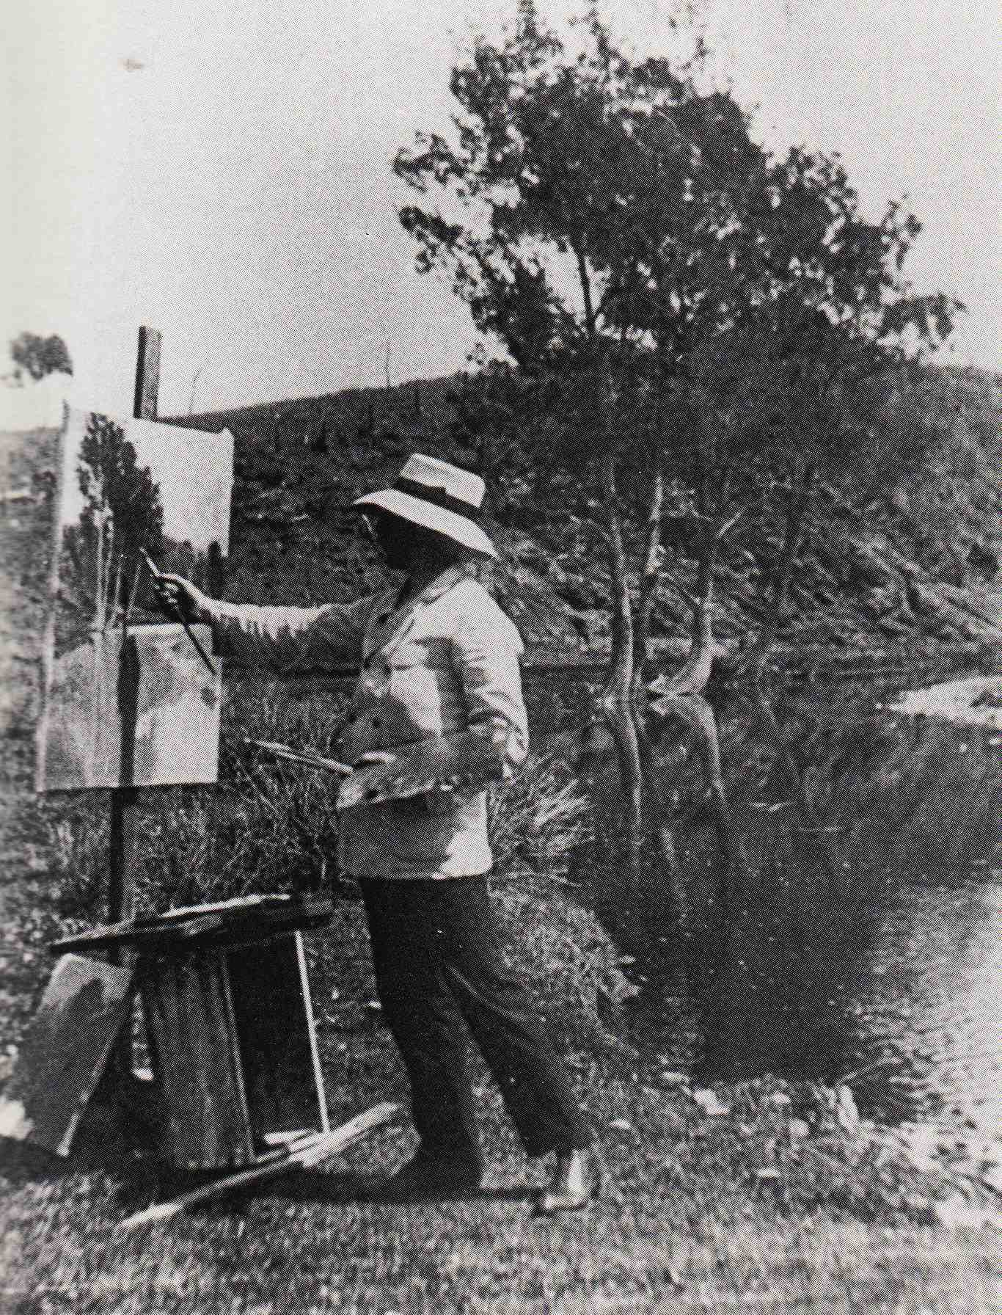
Julian Ashton painting en plein air
(Julian Ashton Art School)

Slide 5
Euroka Camp, Edwards Beach (Balmoral)
The famous cartoonist Livingston Hopkins (‘Hop’) established the camp in 1883. Artists such as Julian Ashton and Henry Fullwood subsequently joined him.
There were tents with wooden floors and carpets. There was a separate dining tent.
The writers Robert Louis Stevenson and Ada Cambridge visited the camp.
1903 legislation allowing for daylight bathing brought crowds of people to the nearby beach and led to the camp’s demise.

Slide 6
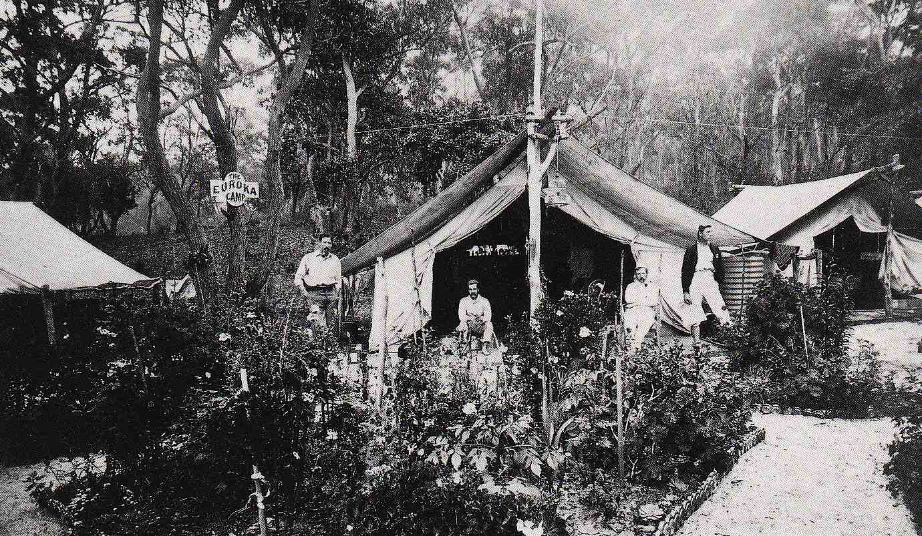
Euroka Camp
(Mosman Library)

Slide 7
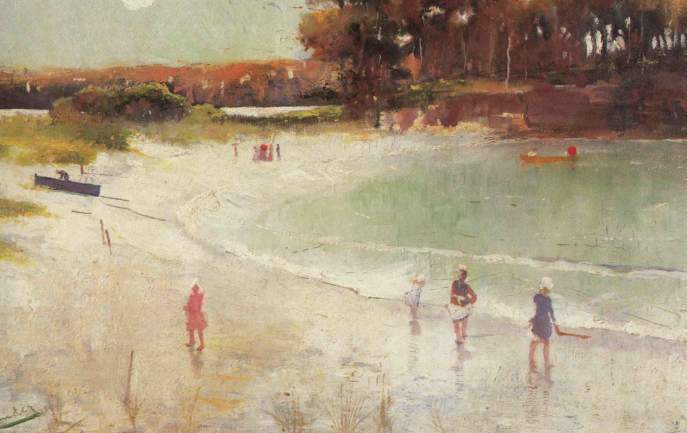
Charles Conder, Balmoral Beach 1888
(private collection)

Slide 8
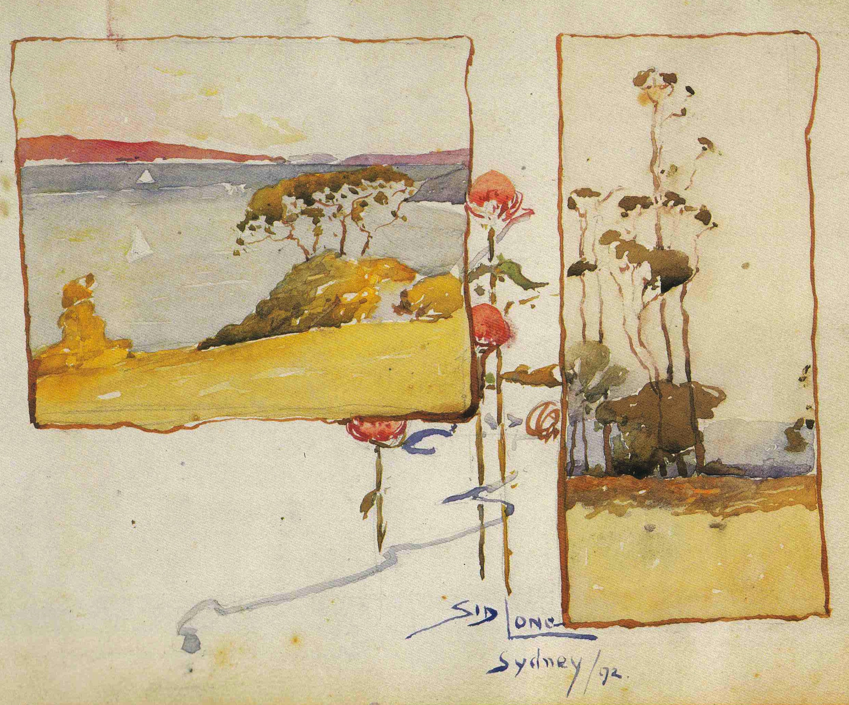
Sydney Long, Balmoral 1892
(private collection)

Slide 9
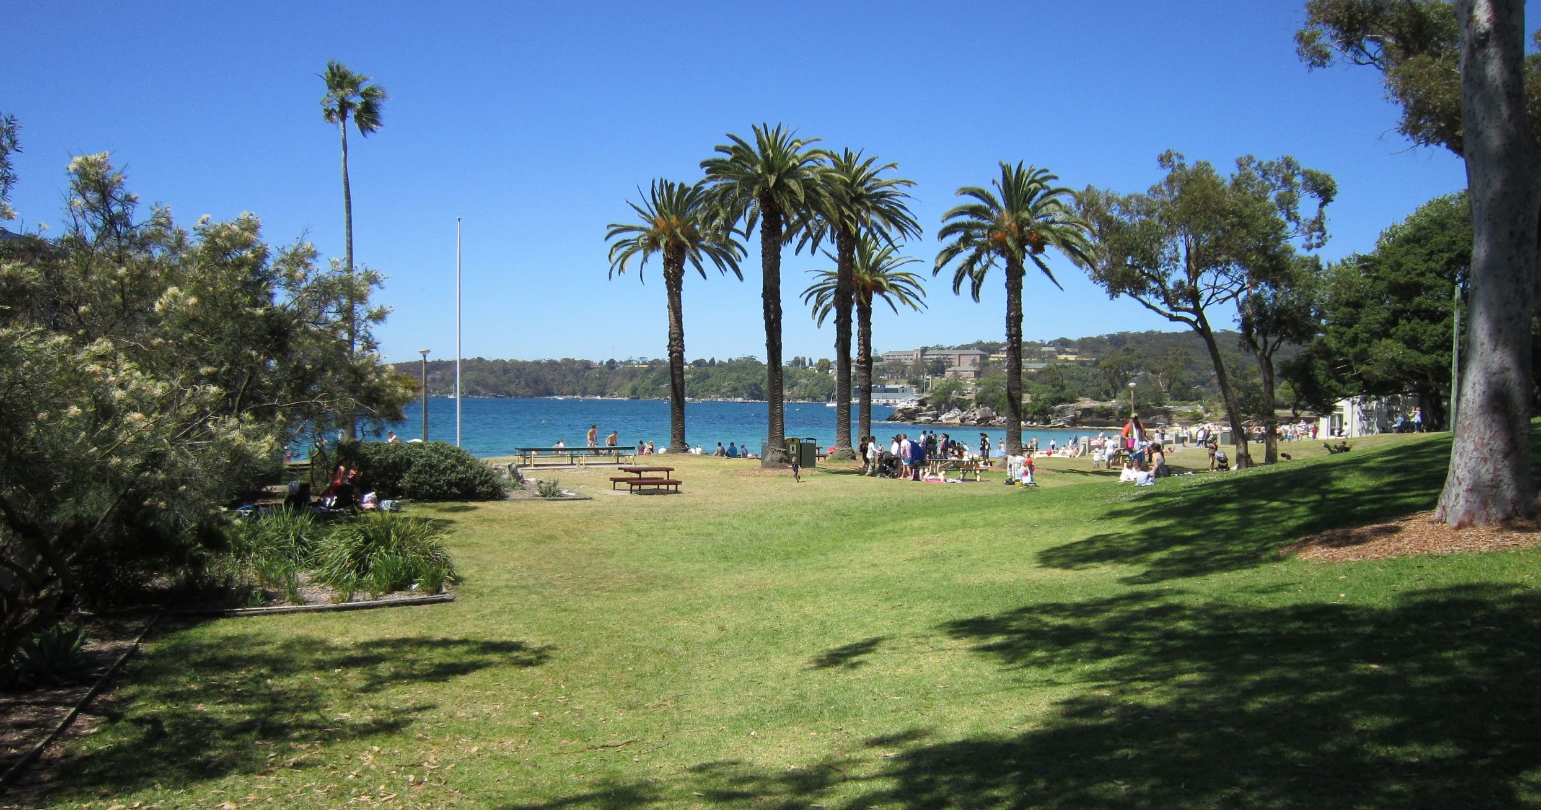
Euroka Camp site in 2015
(David Carment)

Slide 10
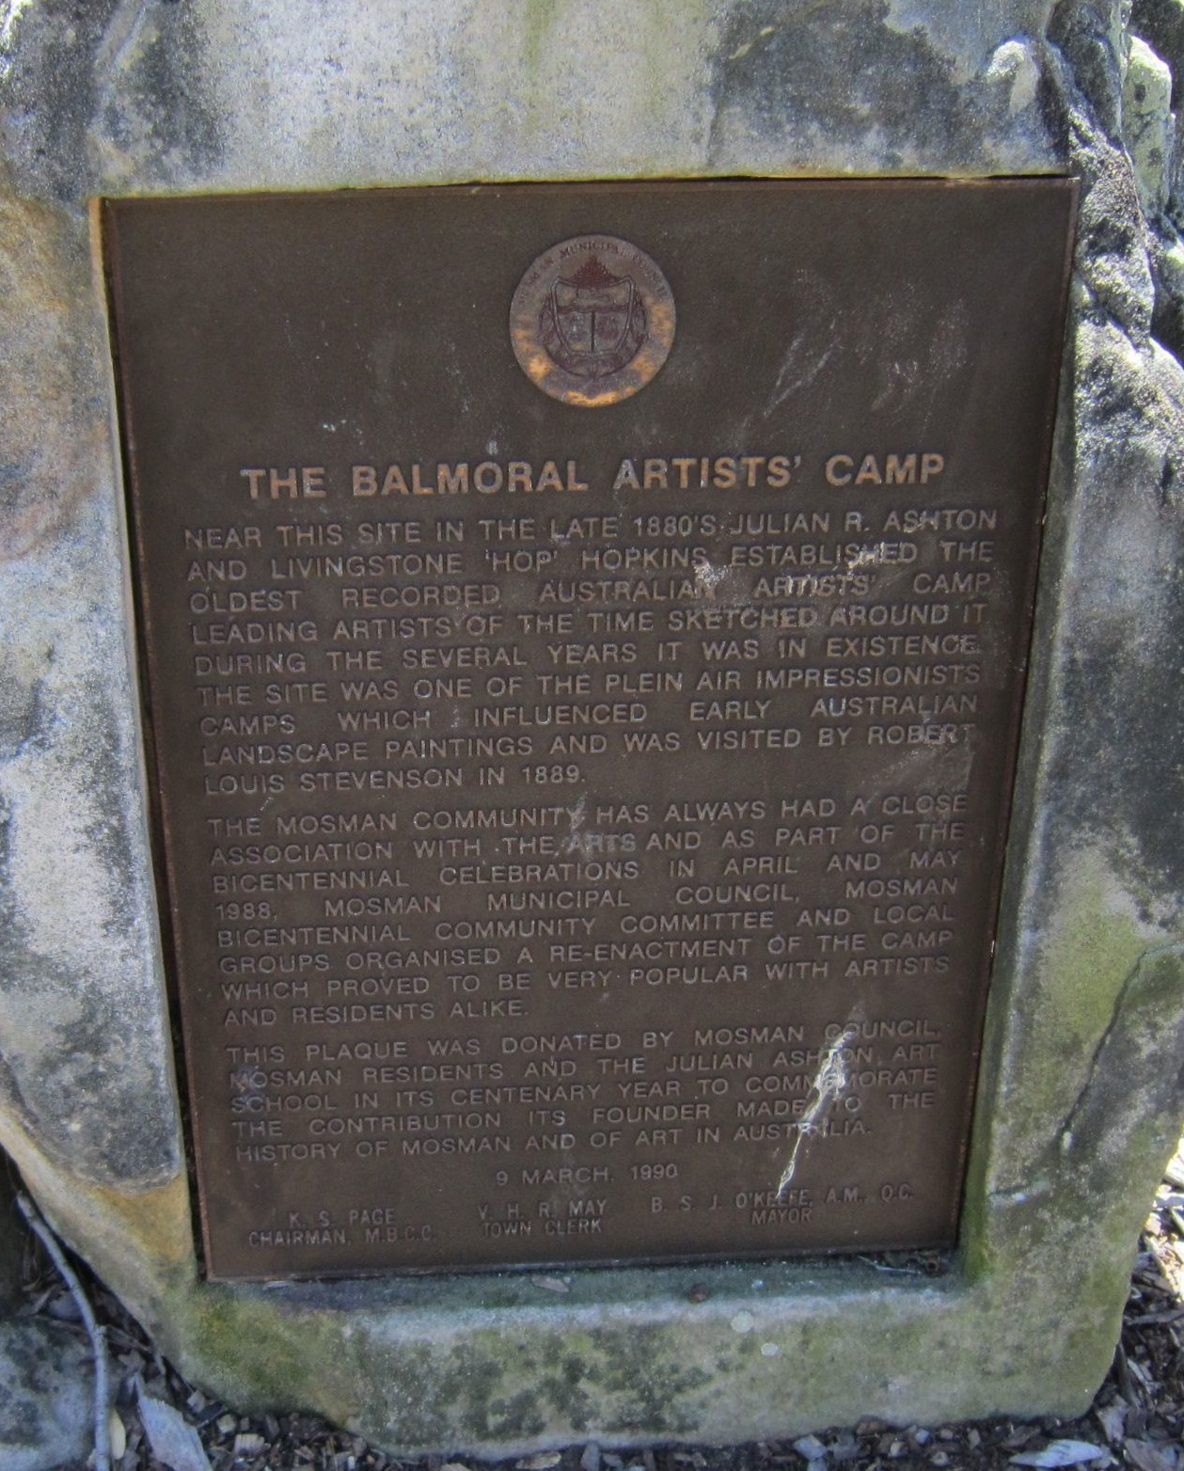
The plaque at Euroka Camp site in 2015
(David Carment)

Slide 11
Curlew Camp, Little Sirius Cove
The camp existed from 1890 to 1912. Its founder was the clothing manufacturer Reuben Brasch.
Tom Roberts and Arthur Streeton painted there between 1890 and 1896.
They and other well known artists lived in tents on the foreshore. The camp had a dining tent, a billiards tent and well maintained gardens. Some of the tents were filled with heavy and ornate furniture.
The camp closed when the decision was made to create Taronga Park Zoo.

Slide 12
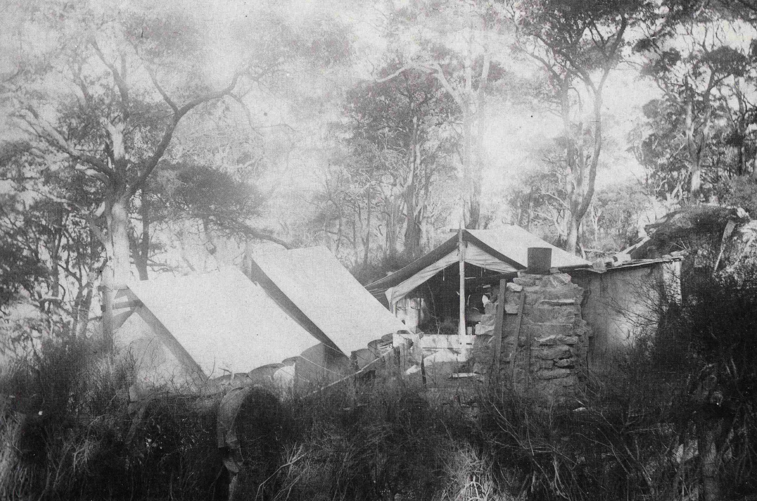
Curlew Camp
(Fred Delmar, private collection)

Slide 13
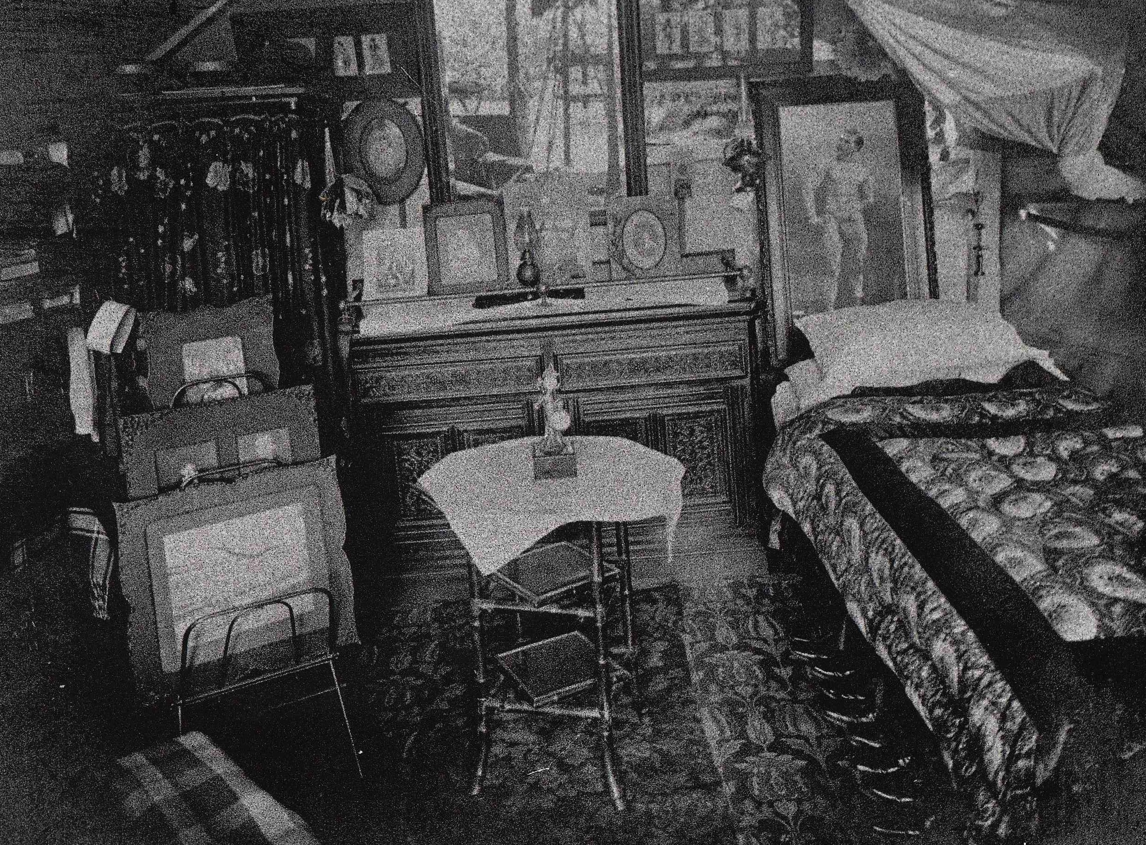
The interior of Fred Lane’s tent at Curlew Camp
(Norman Studios, Jean Rubensohn Collection)

Slide 14
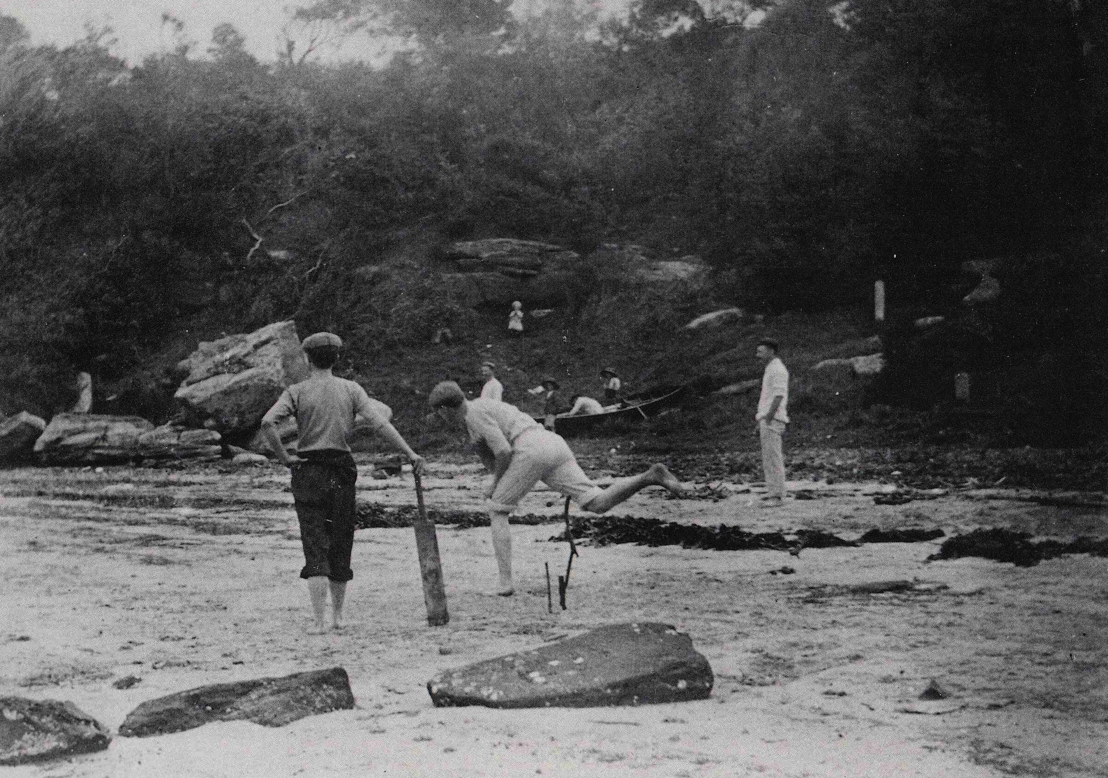
Playing cricket at Whiting Beach near Curlew Camp
(R. Cherry, private collection)

Slide 15
Tom Roberts, The camp, Sirius Cove 1899
(Art Gallery of New South Wales)

Slide 16
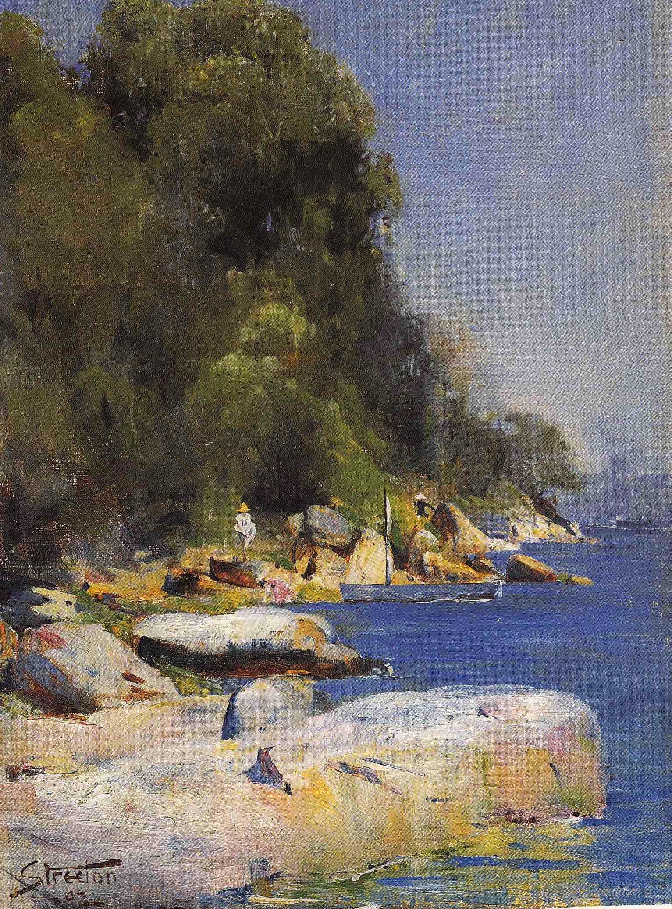
Arthur Streeton, Near Streeton’s Camp at Sirius Cove 1892
(New England Regional Art Museum)

Slide 17
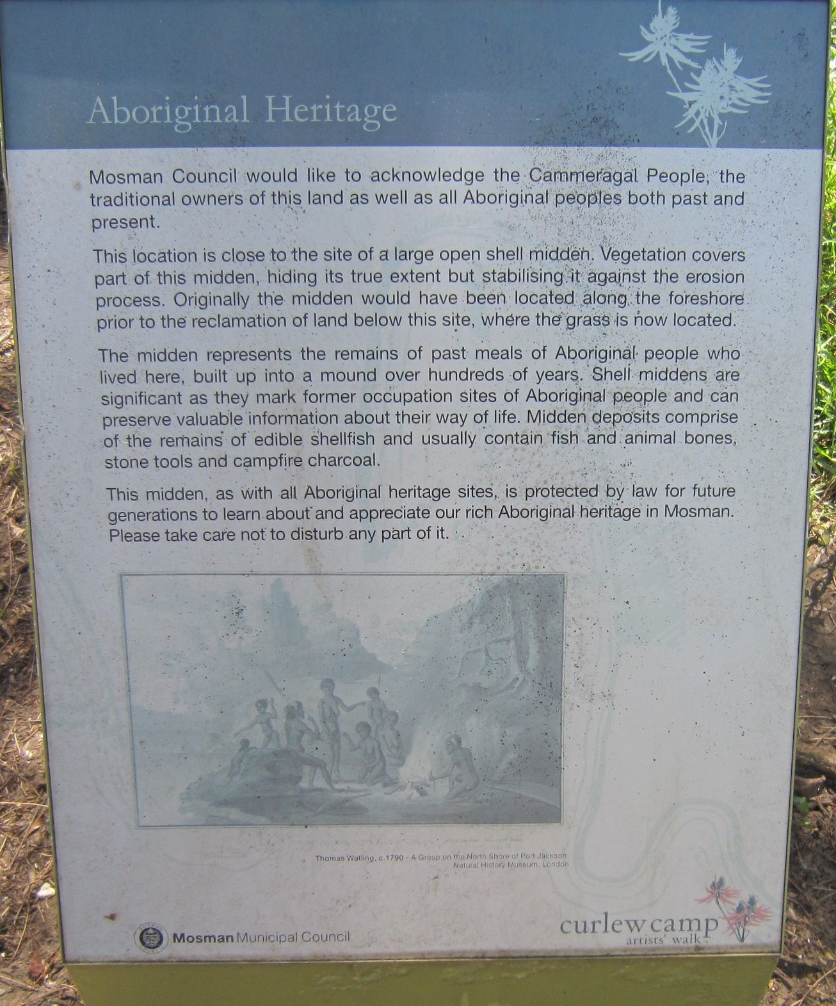
Curlew Camp Artists’ Walk in 2015
(David Carment)

Slide 18
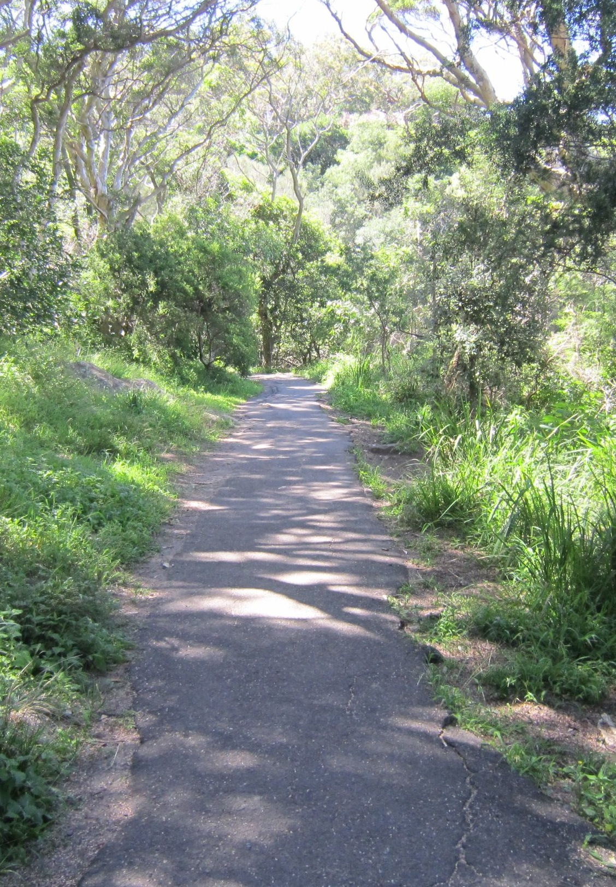
Curlew Camp Artists’ Walk in 2015
(David Carment)

Slide 19
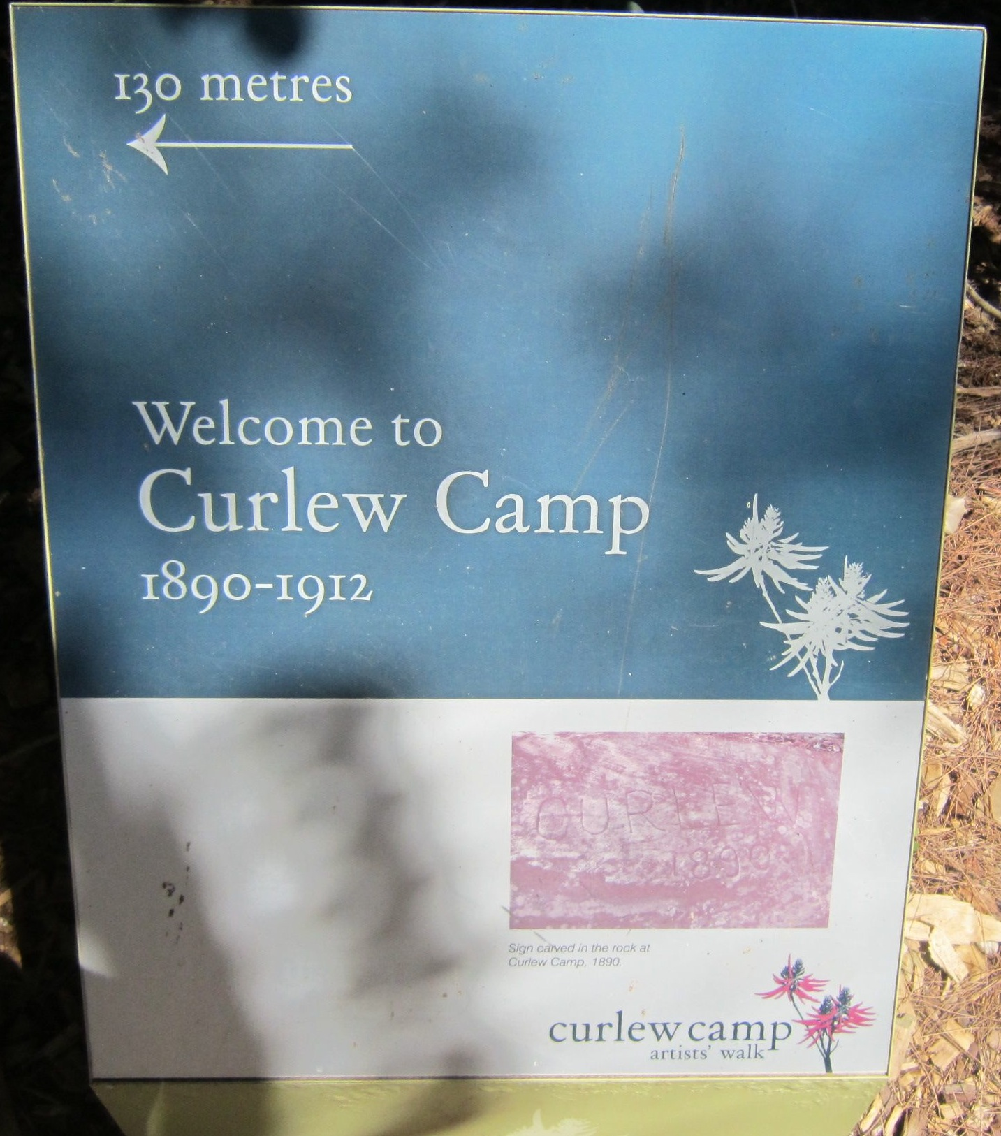
Curlew Camp Artists’ Walk in 2015
(David Carment)

Slide 20
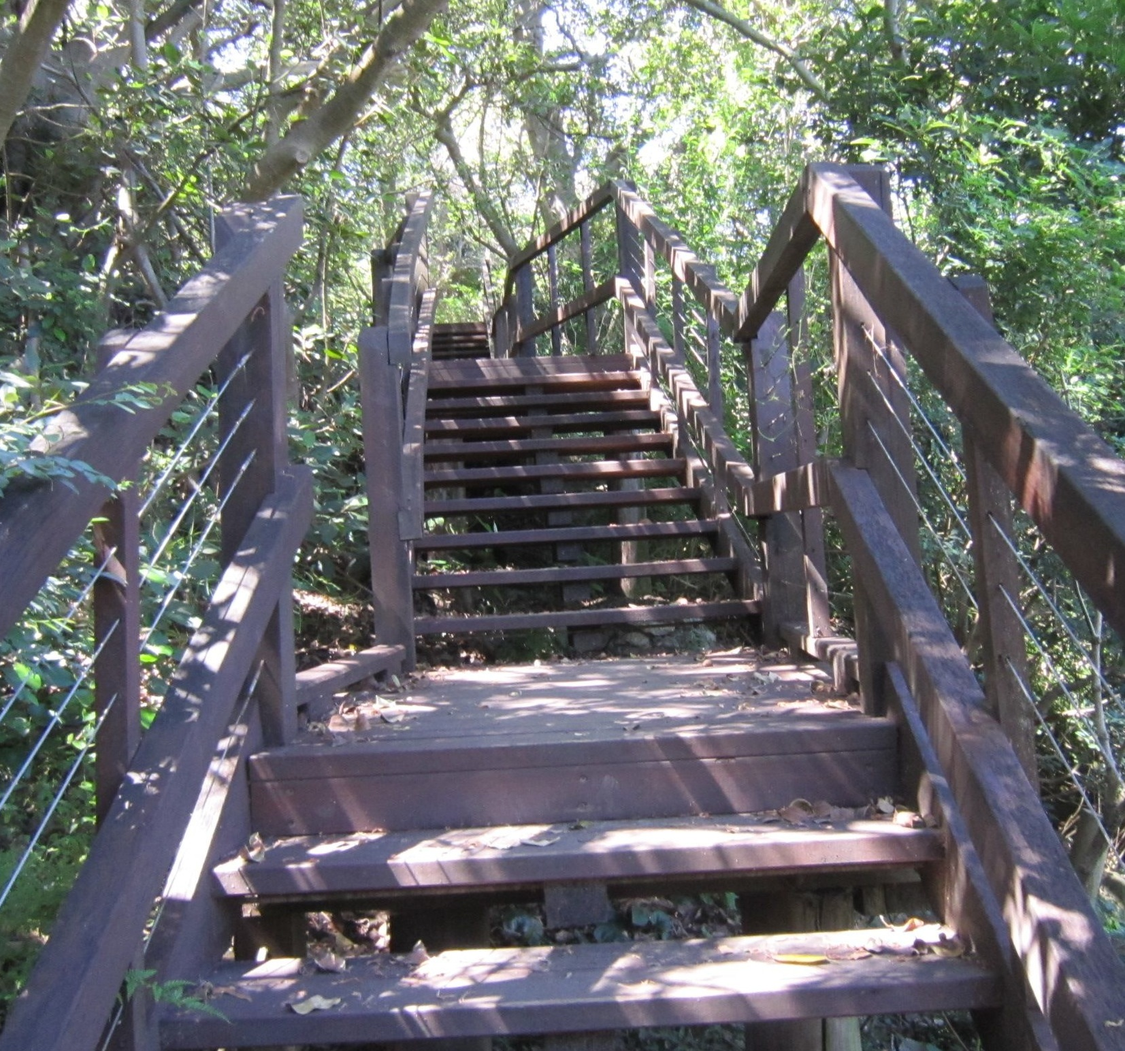
Curlew Camp Artists’ Walk in 2015
(David Carment)

Slide 21
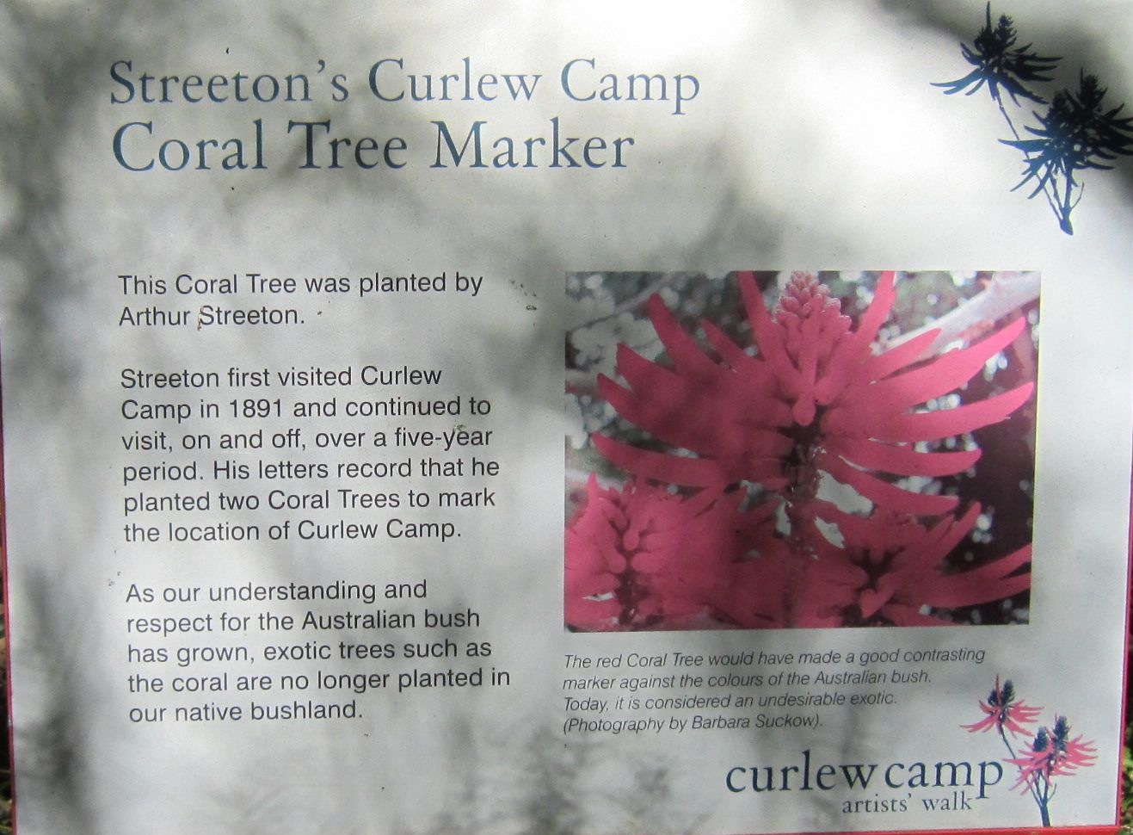
Curlew Camp site in 2015
(David Carment)

Slide 22
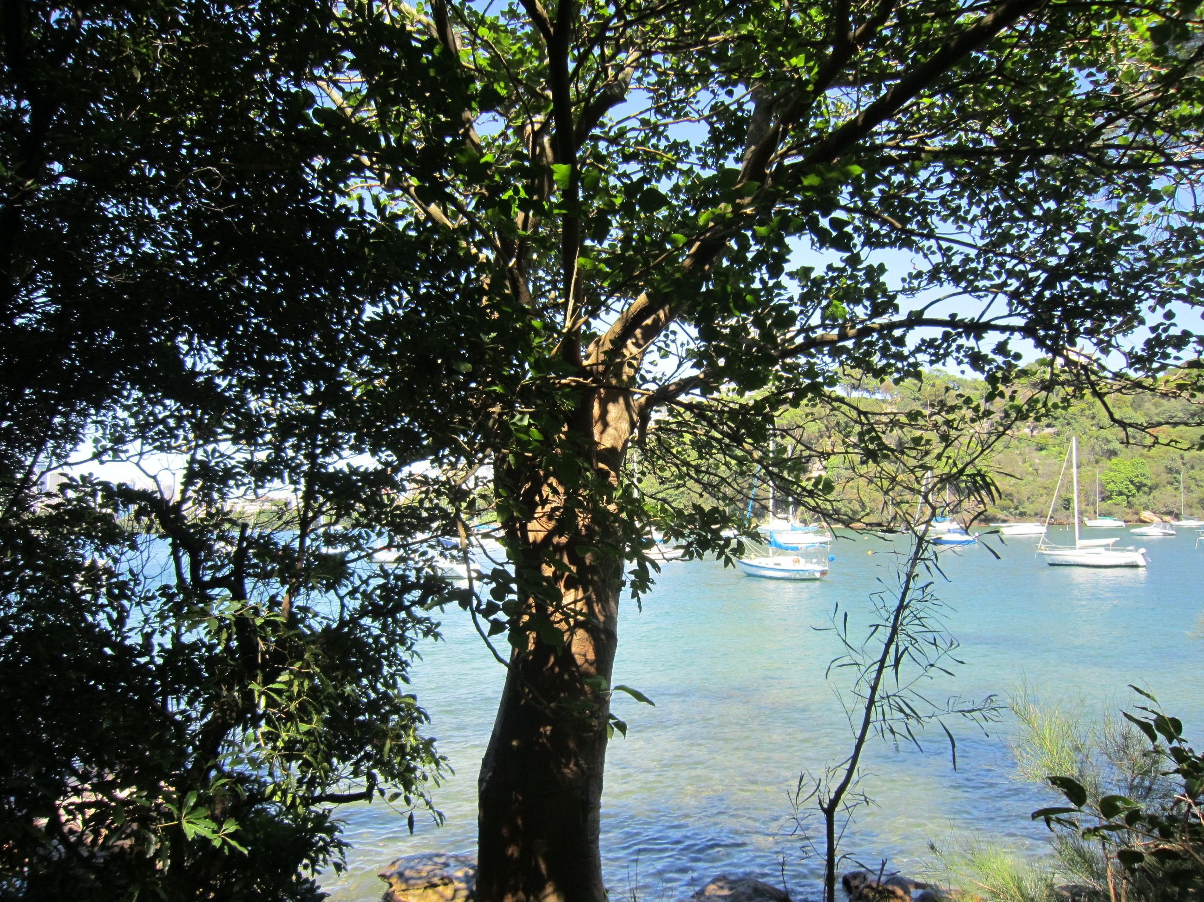
Arthur Streeton’s tree at Curlew Camp site in 2015
(David Carment)

Slide 23
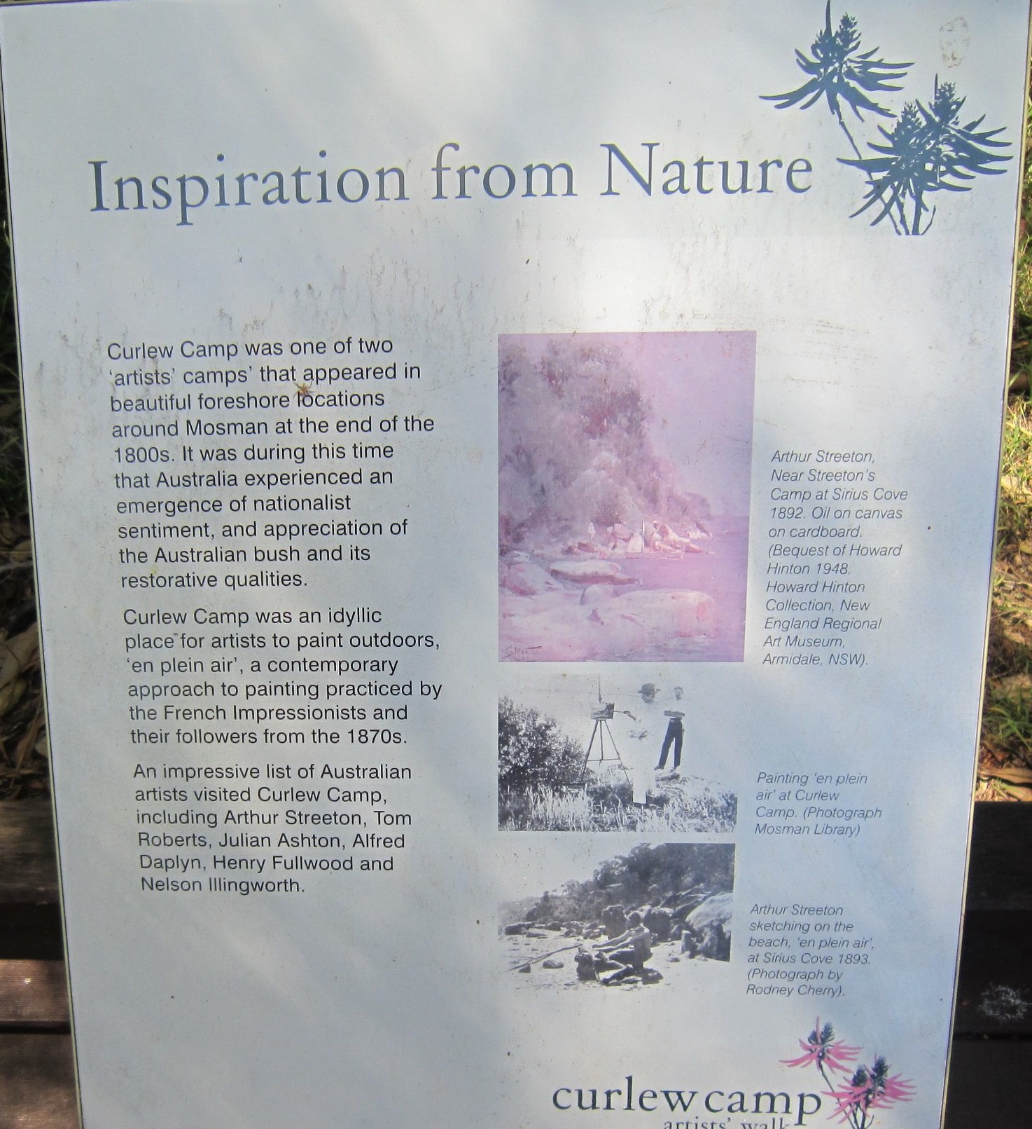
Curlew Camp site in 2015
(David Carment)

Slide 24
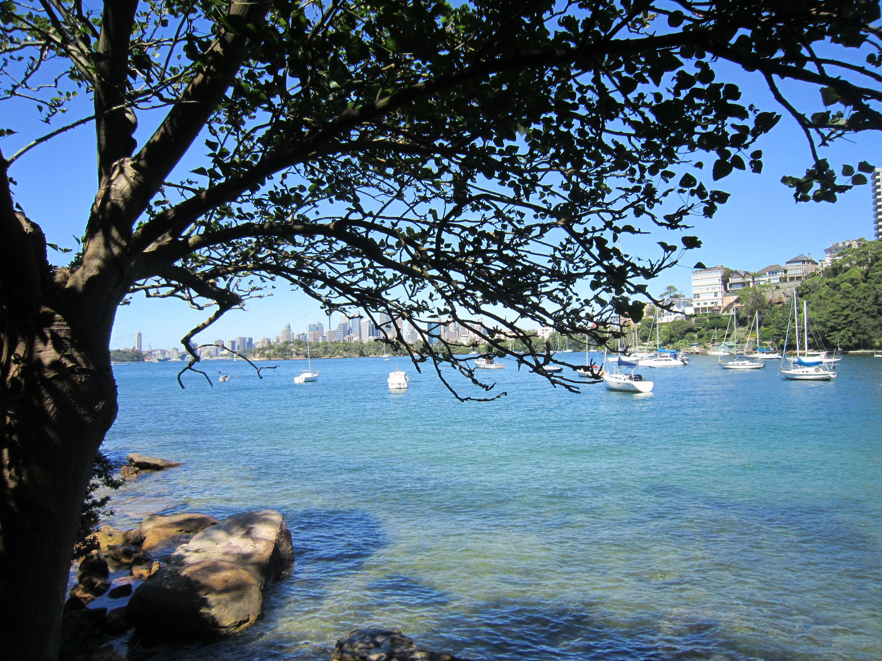
The view of Little Sirius Cove from Curlew Camp site in 2015
(David Carment)

Slide 25
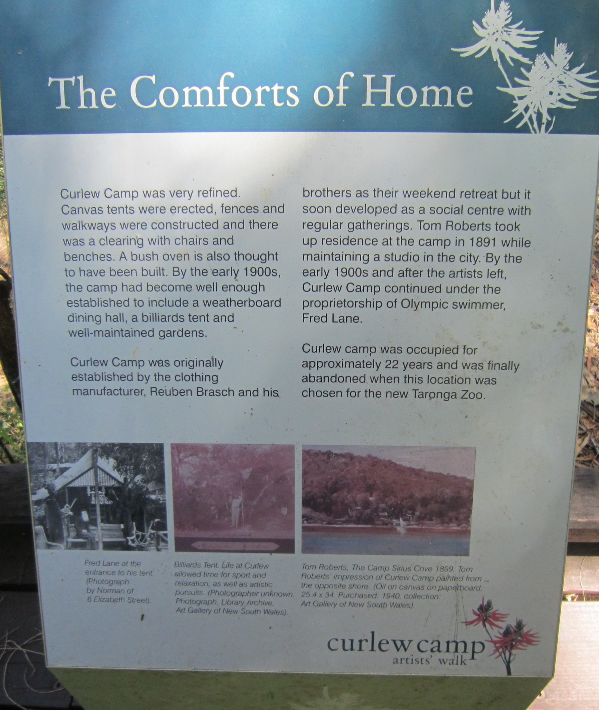
Curlew Camp site in 2015
(David Carment)

Slide 26
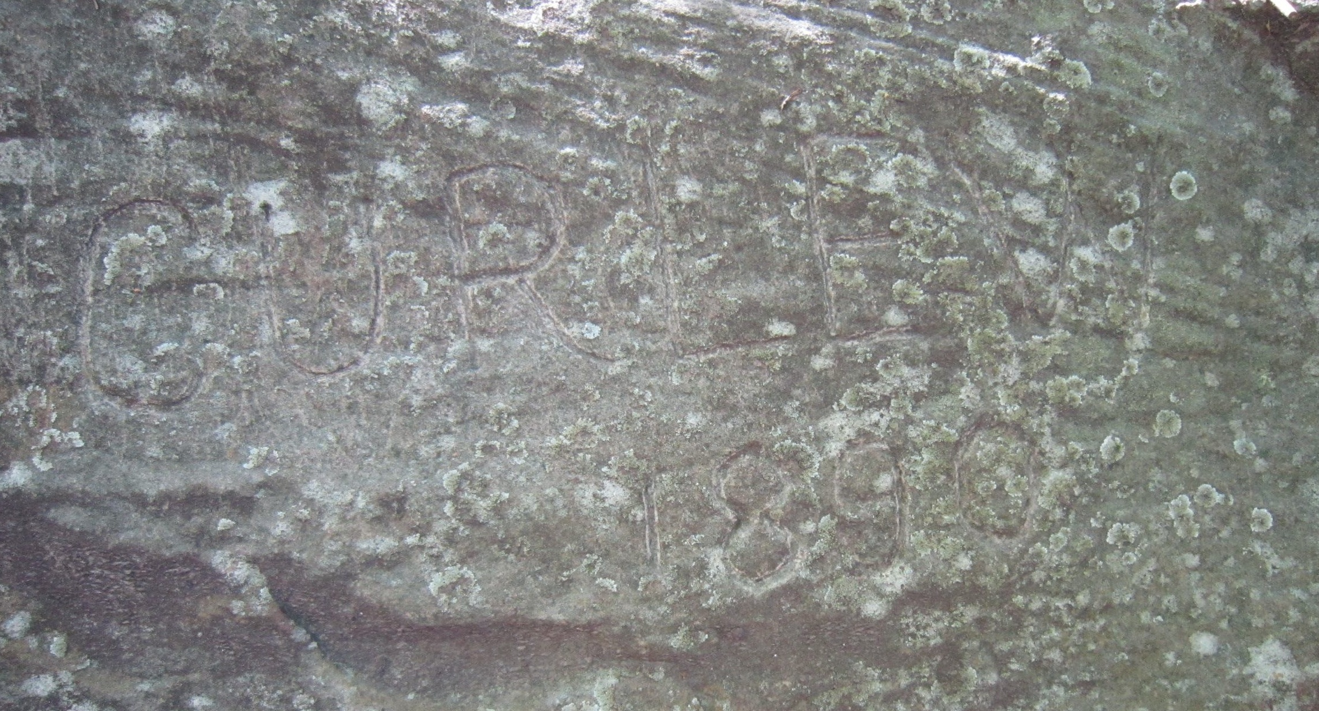
‘CURLEW 1890’ at Curlew Camp site in 2015
(David Carment)

Slide 27
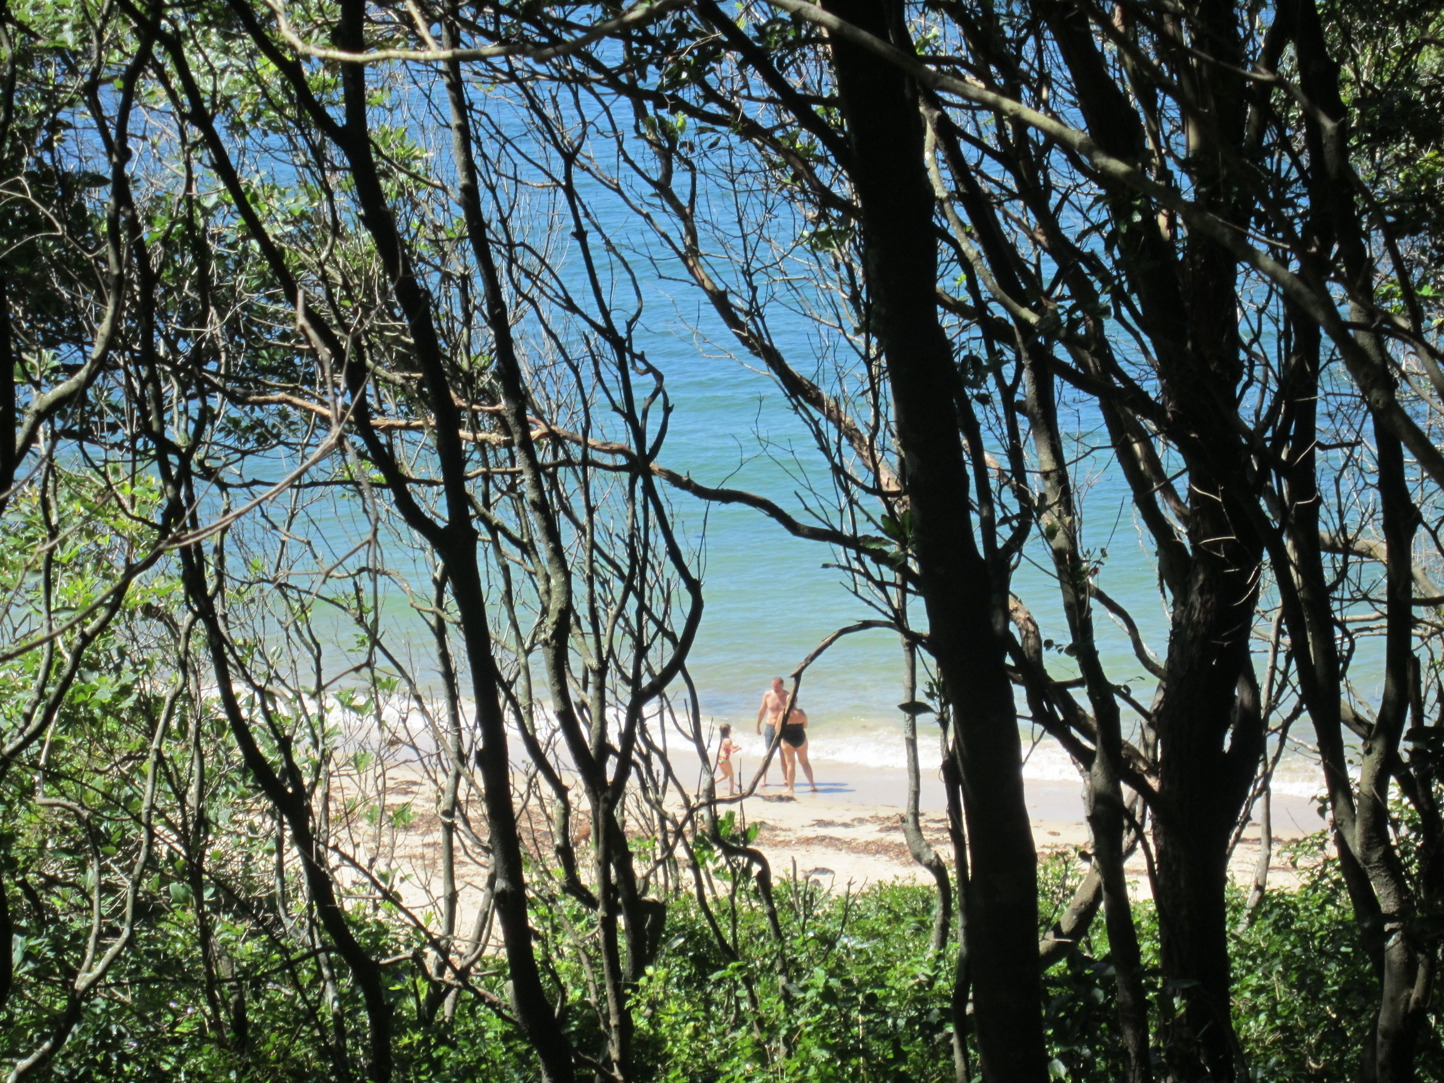
Whiting Beach in 2015
(David Carment)

Slide 28
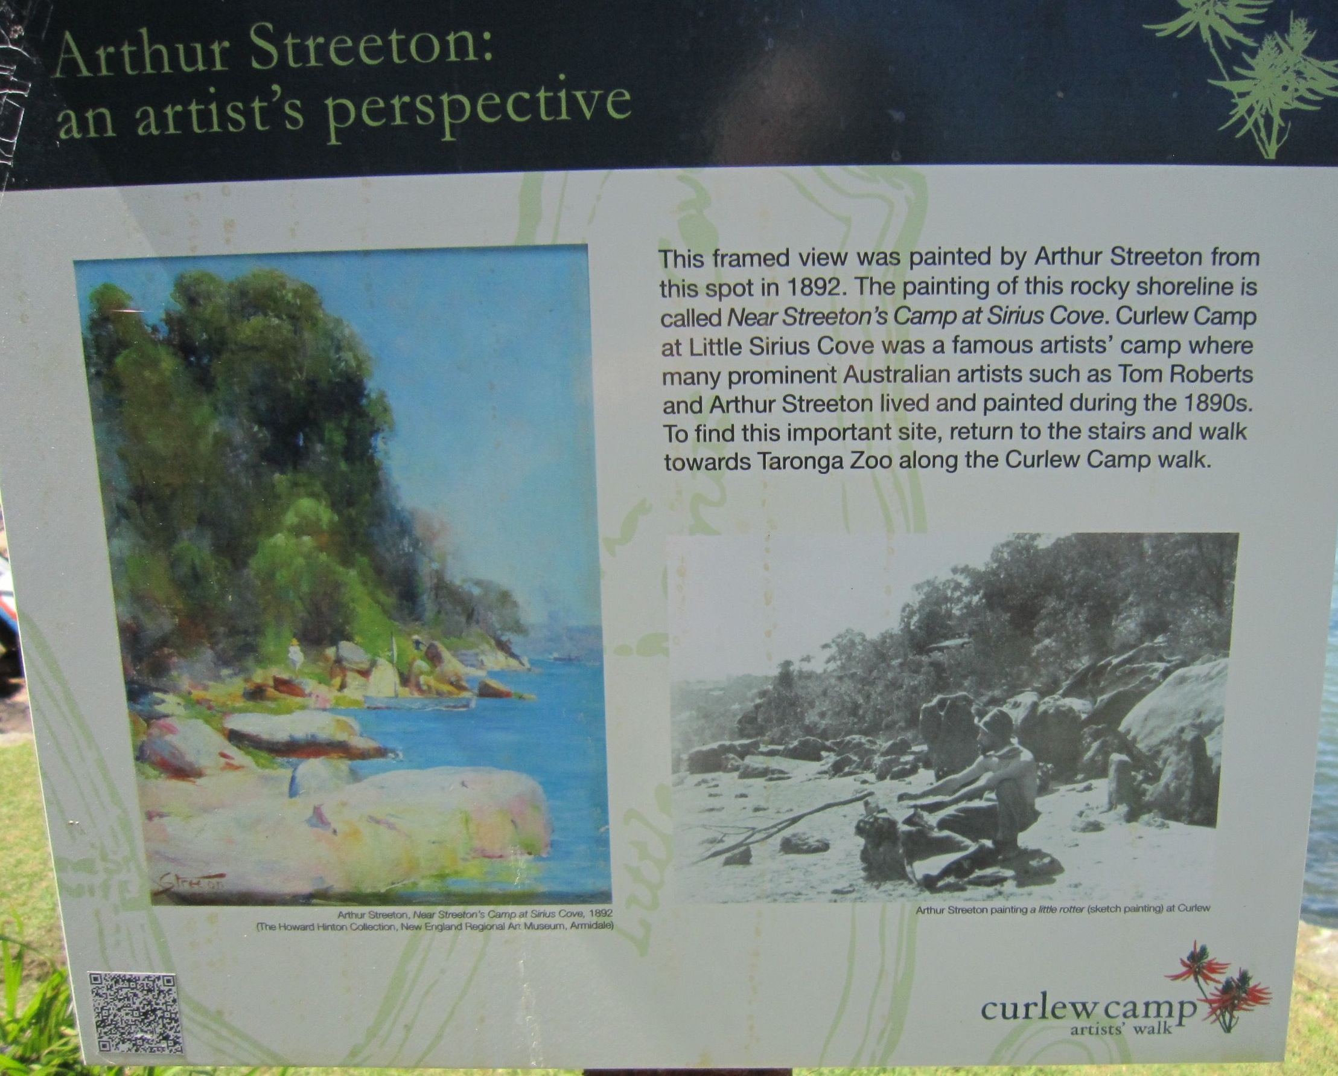
Little Sirius Cove 2015
(David Carment)

Slide 29
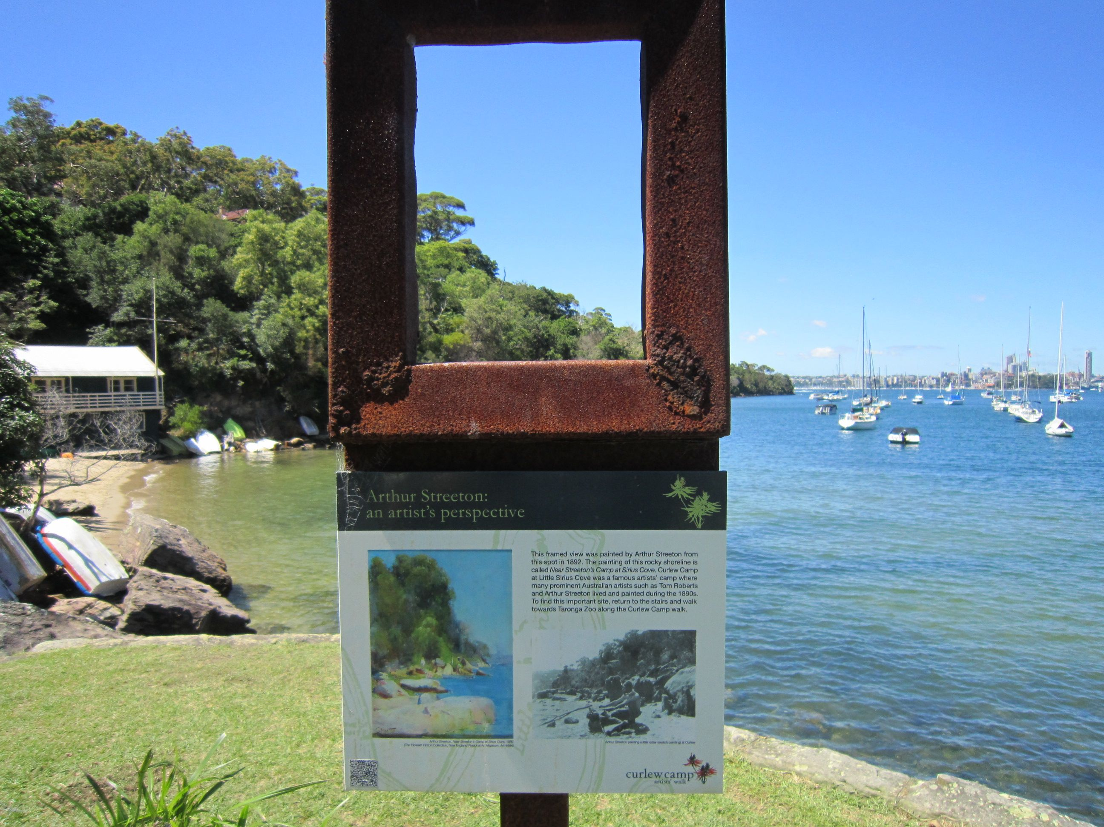
Little Sirius Cove 2015
(David Carment)

Slide 30
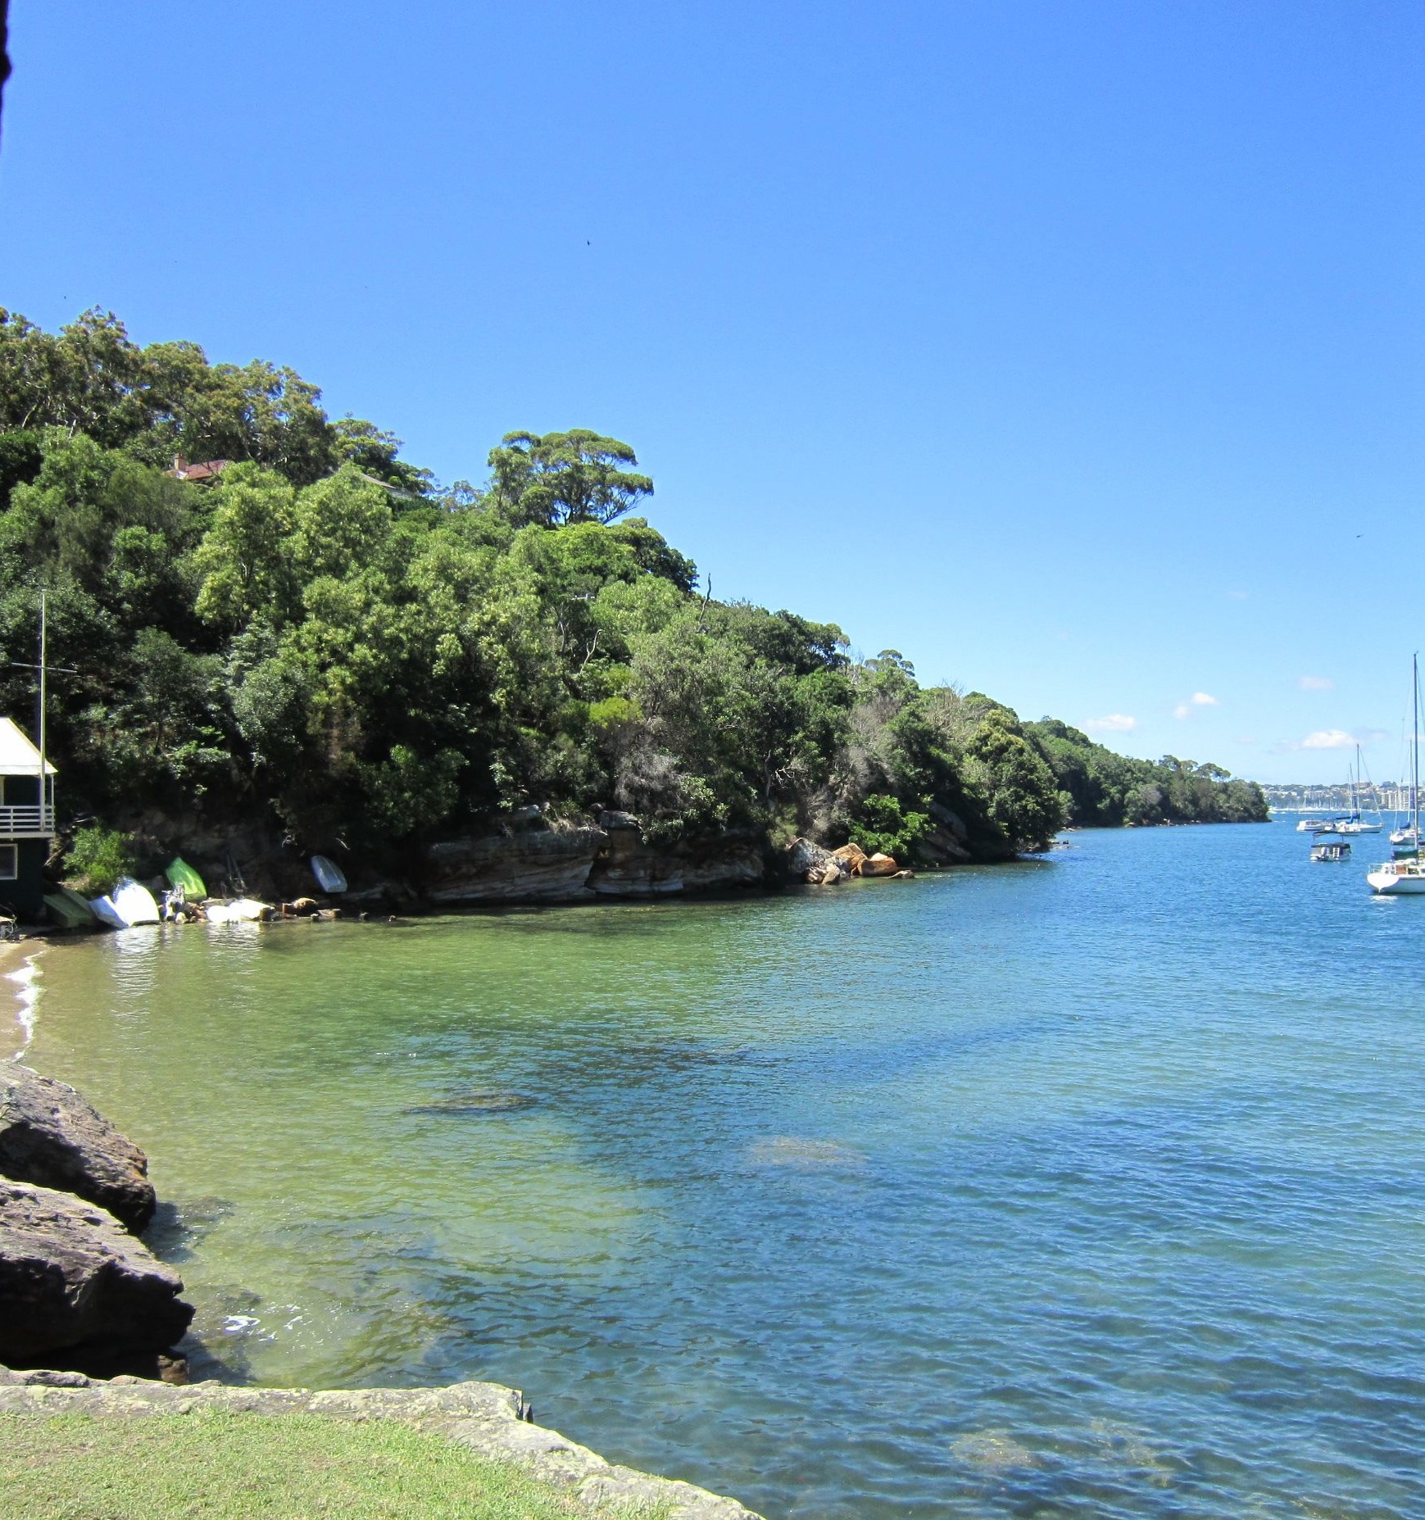
Arthur Streeton’s perspective at Little Sirius Cove 2015
(David Carment)

Slide 31
Further Information
Curlew Artists’ Camp Self-Guided Tour | Mosman Art Gallery, http://mosmanartgallery.org.au/exhibitions/curlew-artists-camp-self-guided-tour, accessed 30 December 2015 (download app).
Mosman Historical Society, Historic Guide to Balmoral & Historic Guide to the Bradleys Head Area, Mosman, 2010.
Gavin Souter, Time & Tides: A Middle Harbour Memoir, Simon & Schuster, Sydney, 2004.
Albie Thoms et al, Bohemians in the Bush: The Artists’ Camps of Mosman, Art Gallery of New South Wales, Sydney, 1991.

