Slide 1
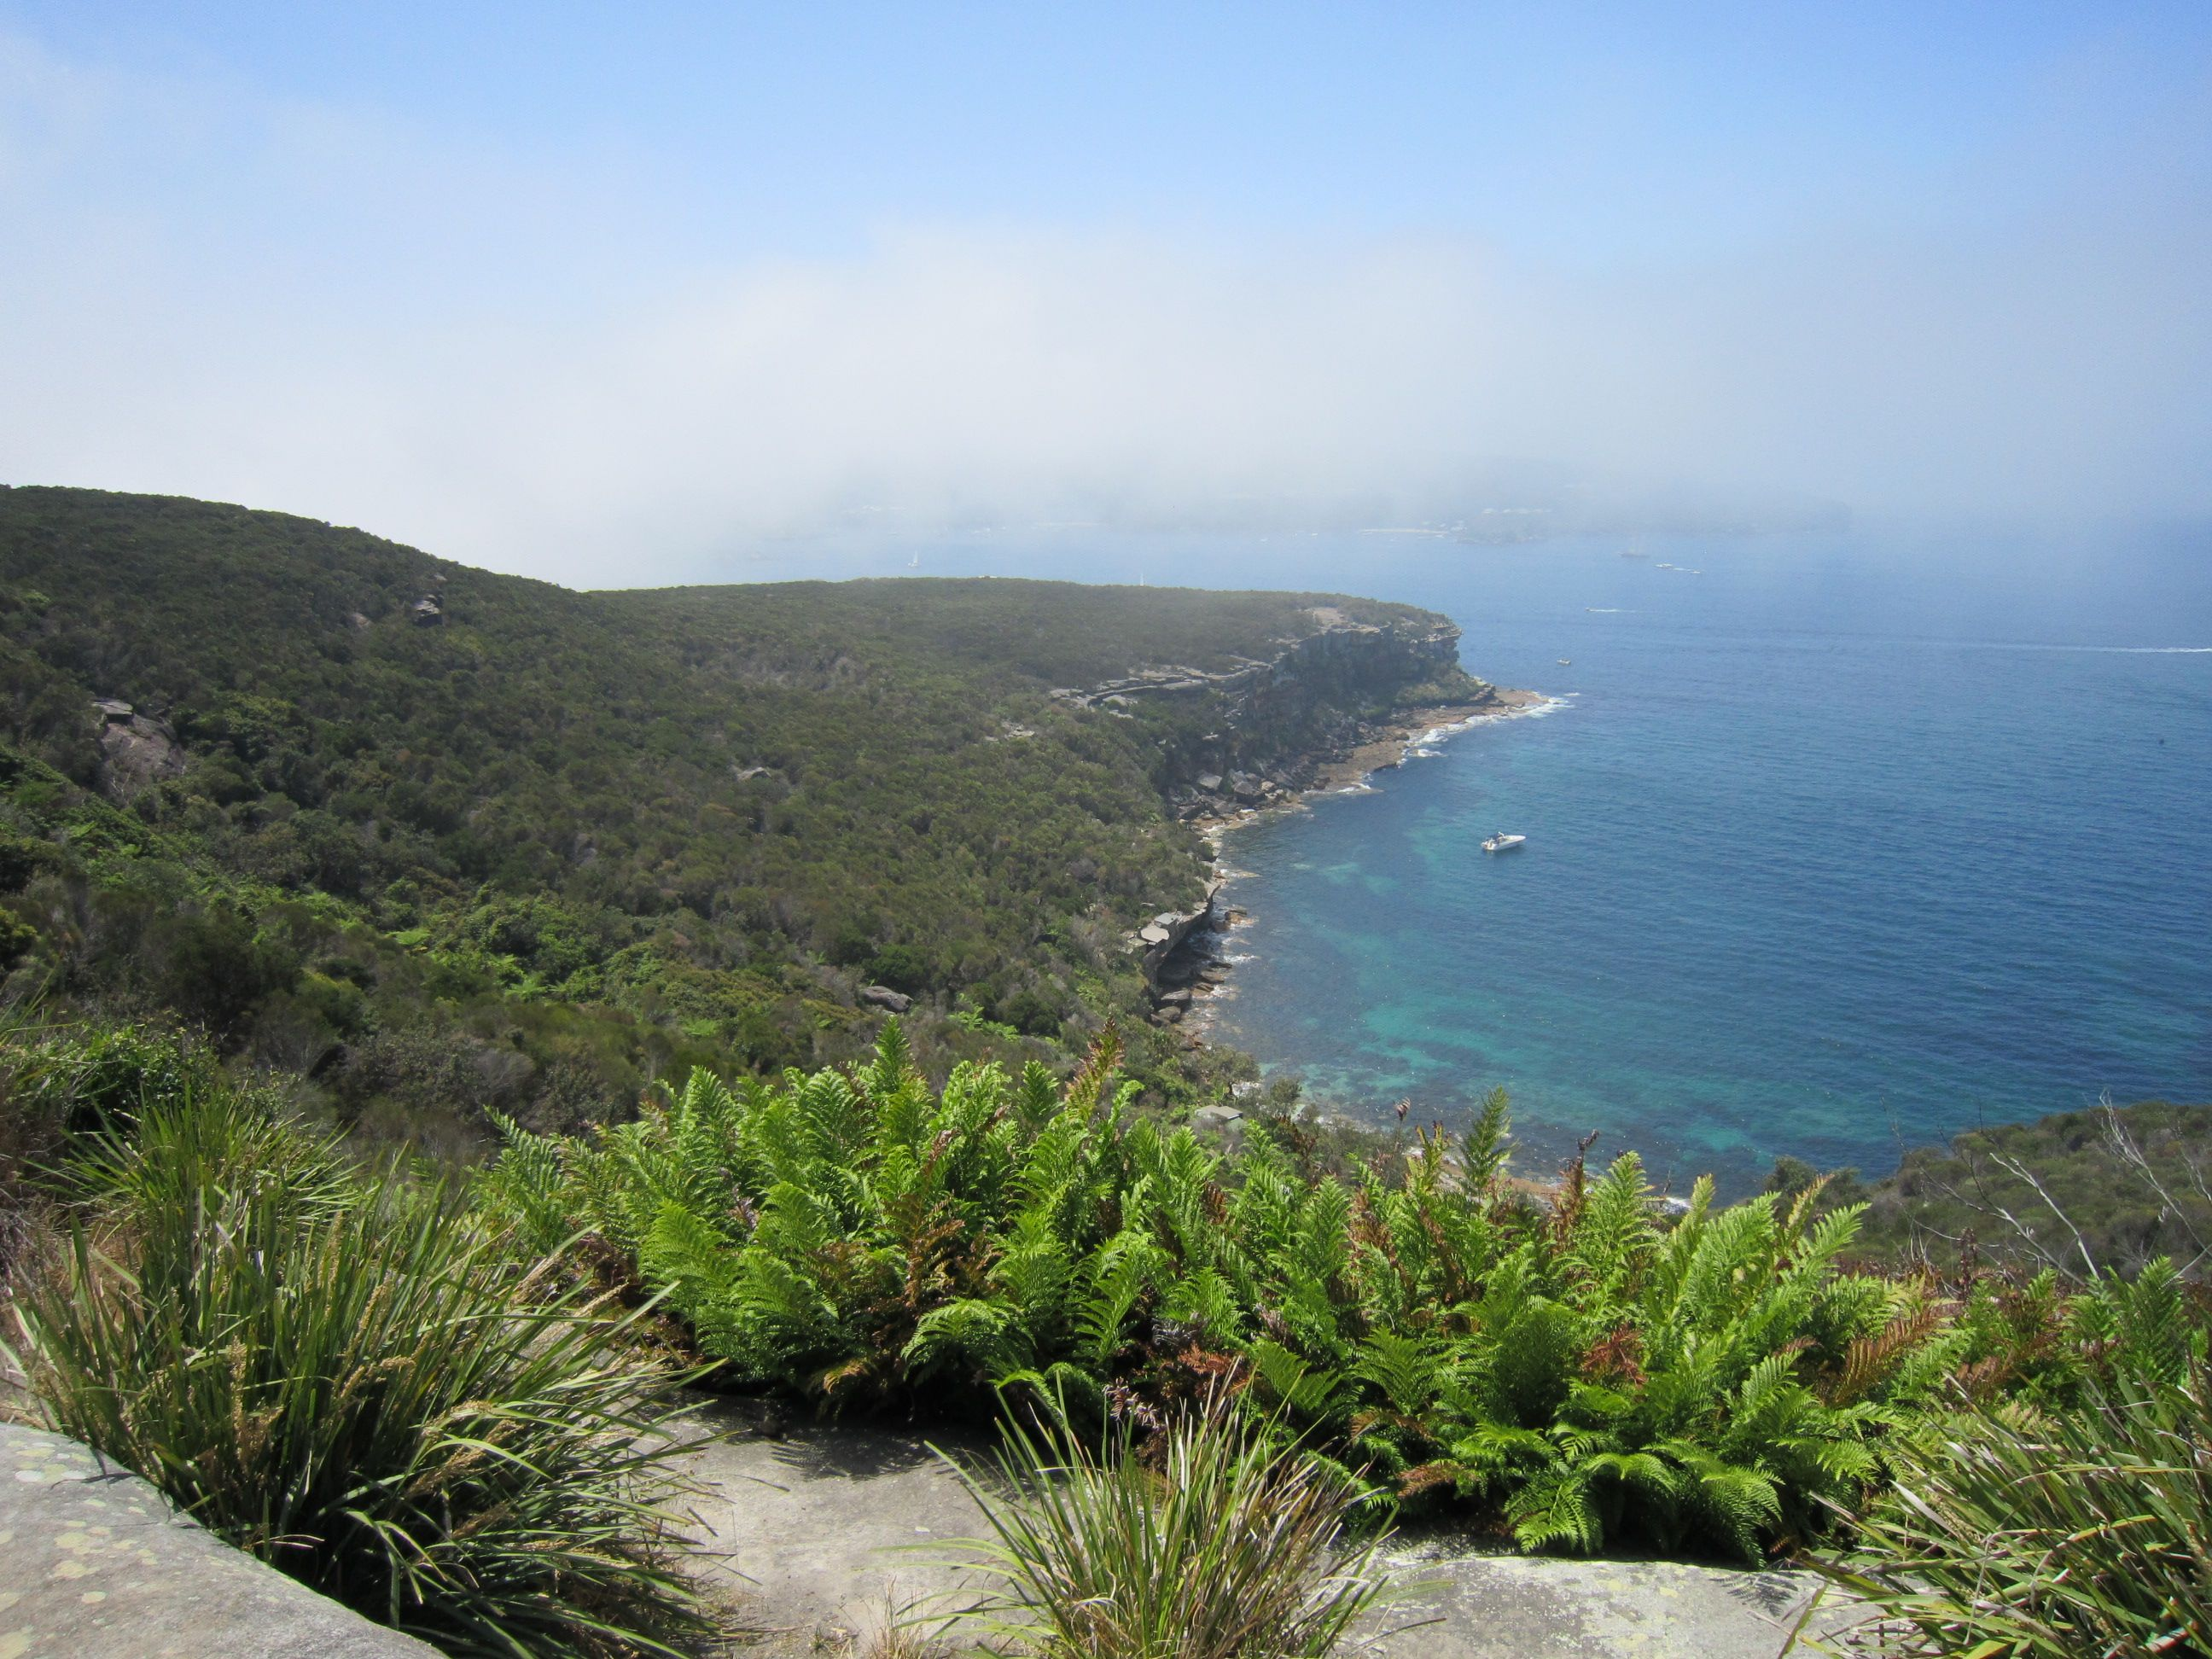
Walking through history between The Spit and Manly
David Carment
All photographs in this presentation are by David Carment.

Slide 2
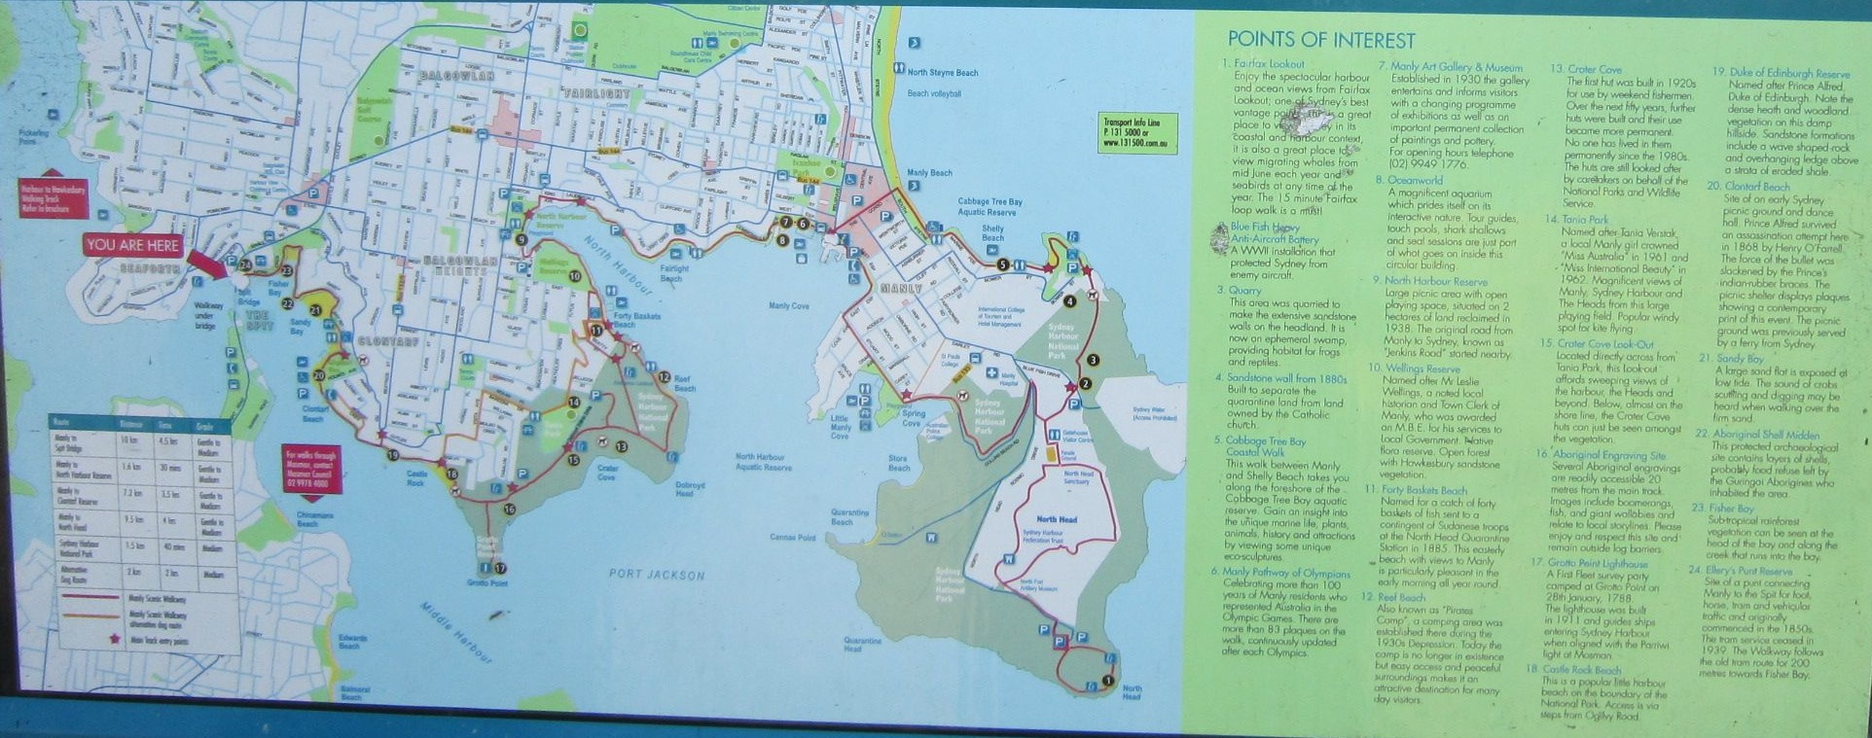
Map of walk

Slide 3
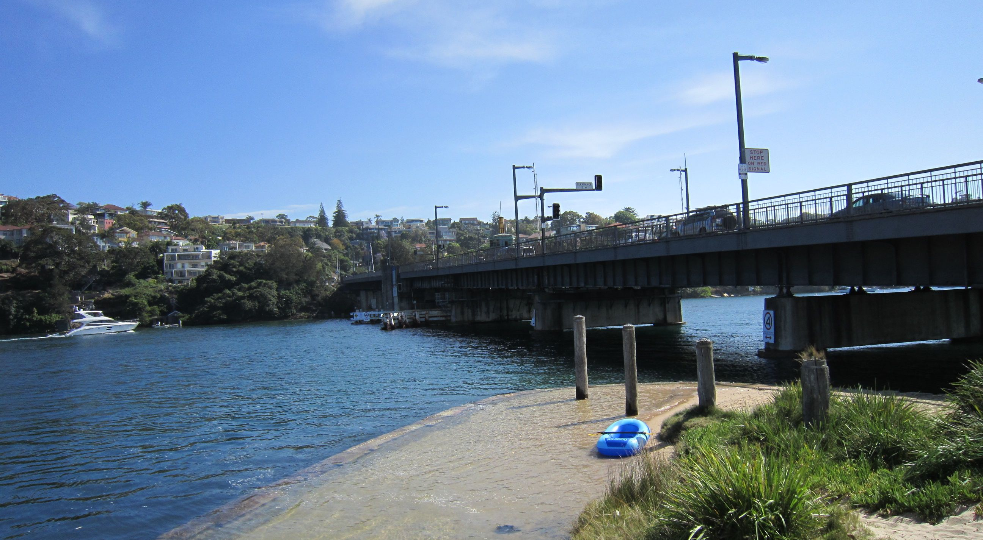
The Spit Bridge
The present bridge was completed in 1958, replacing the first bridge that opened in 1924.

Slide 4
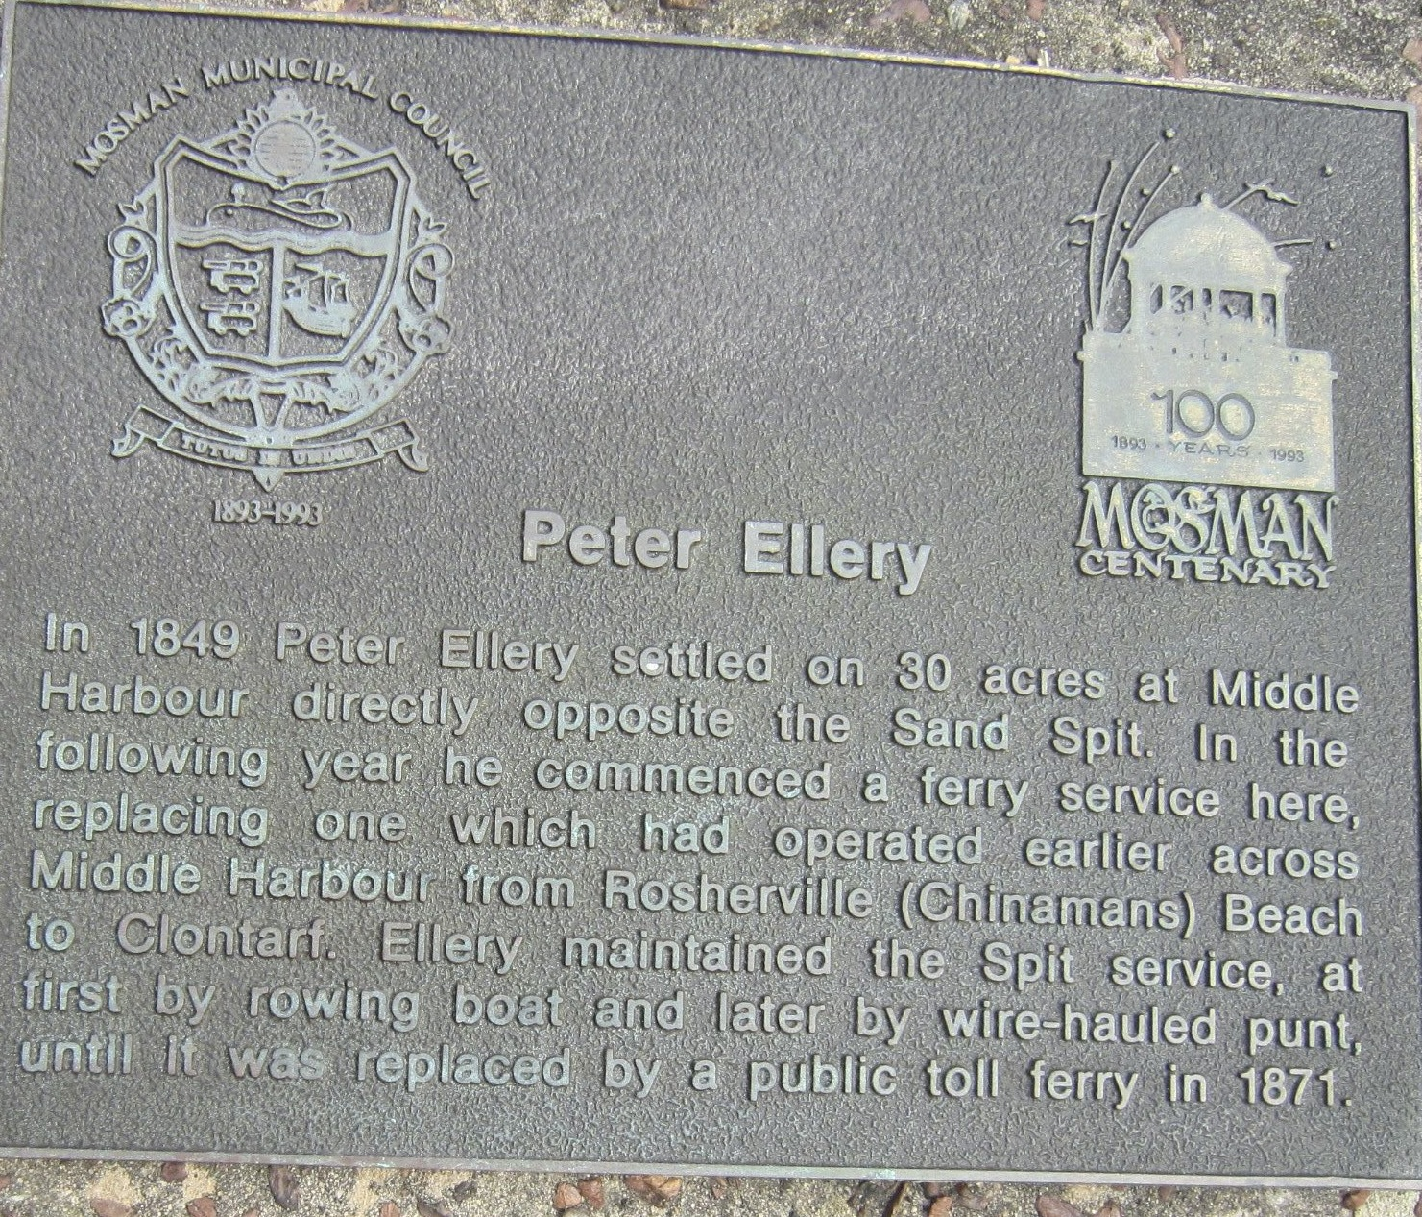
Plaque near Spit Bridge

Slide 5
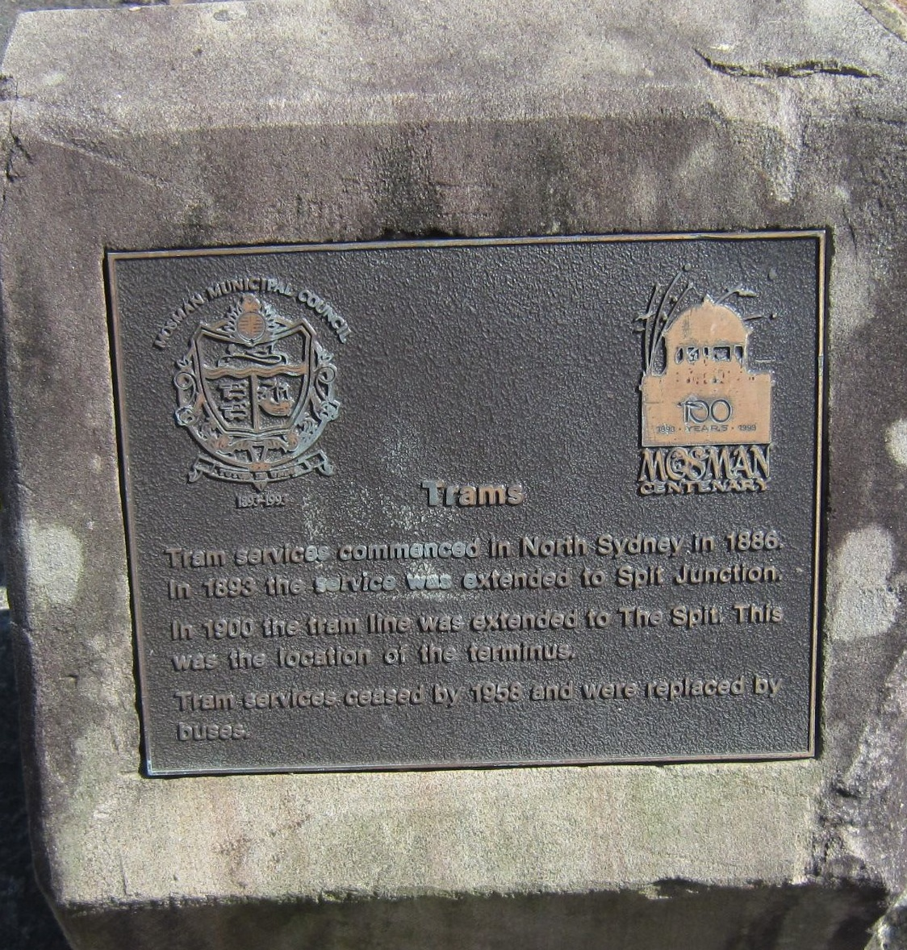
Plaque near Spit Bridge

Slide 6
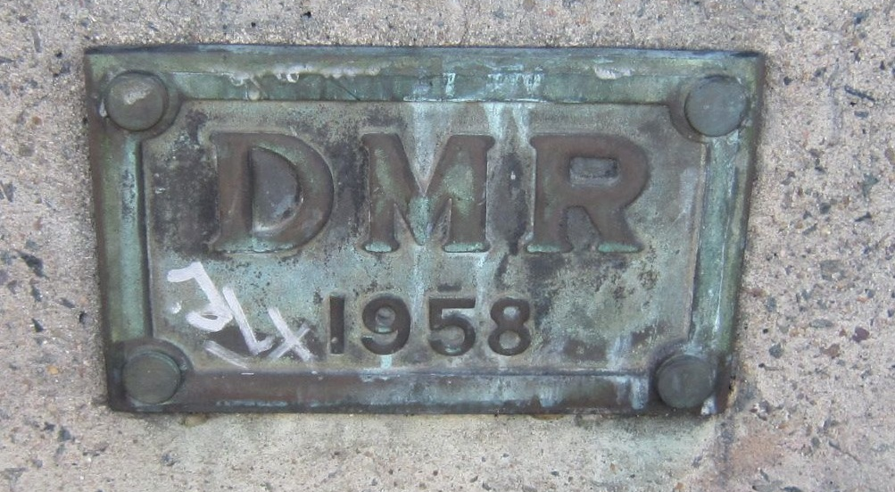
Plaque on Spit Bridge

Slide 7
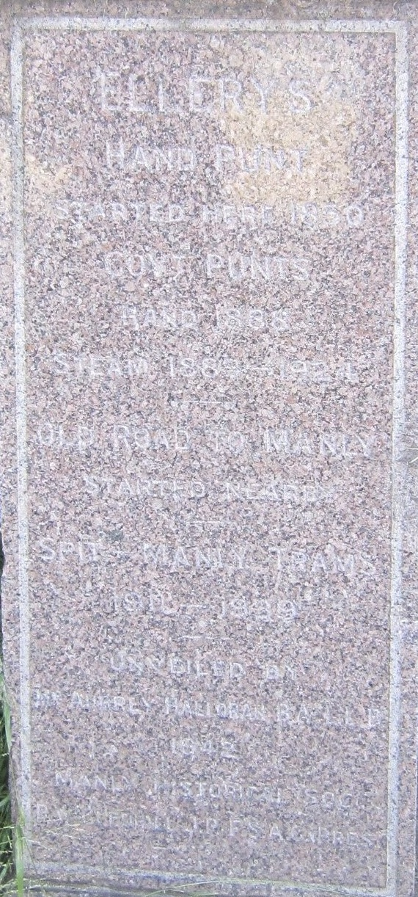
Monument near Spit Bridge

Slide 8
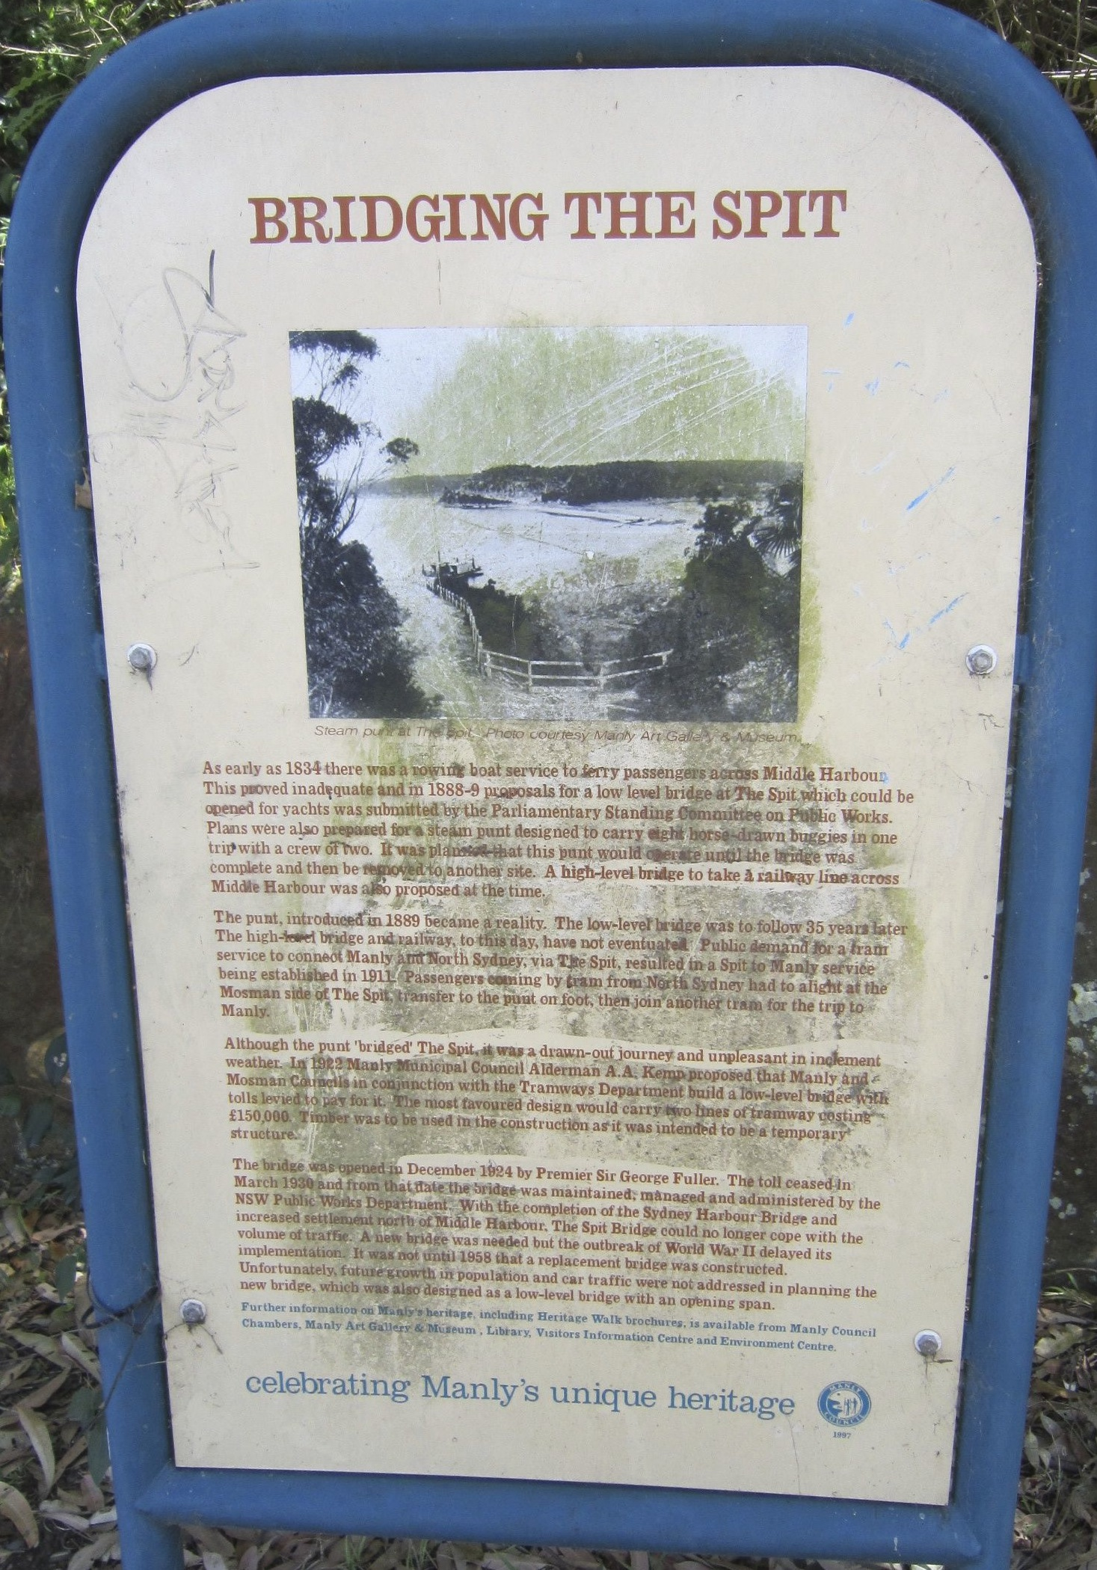
Sign near Spit Bridge

Slide 9
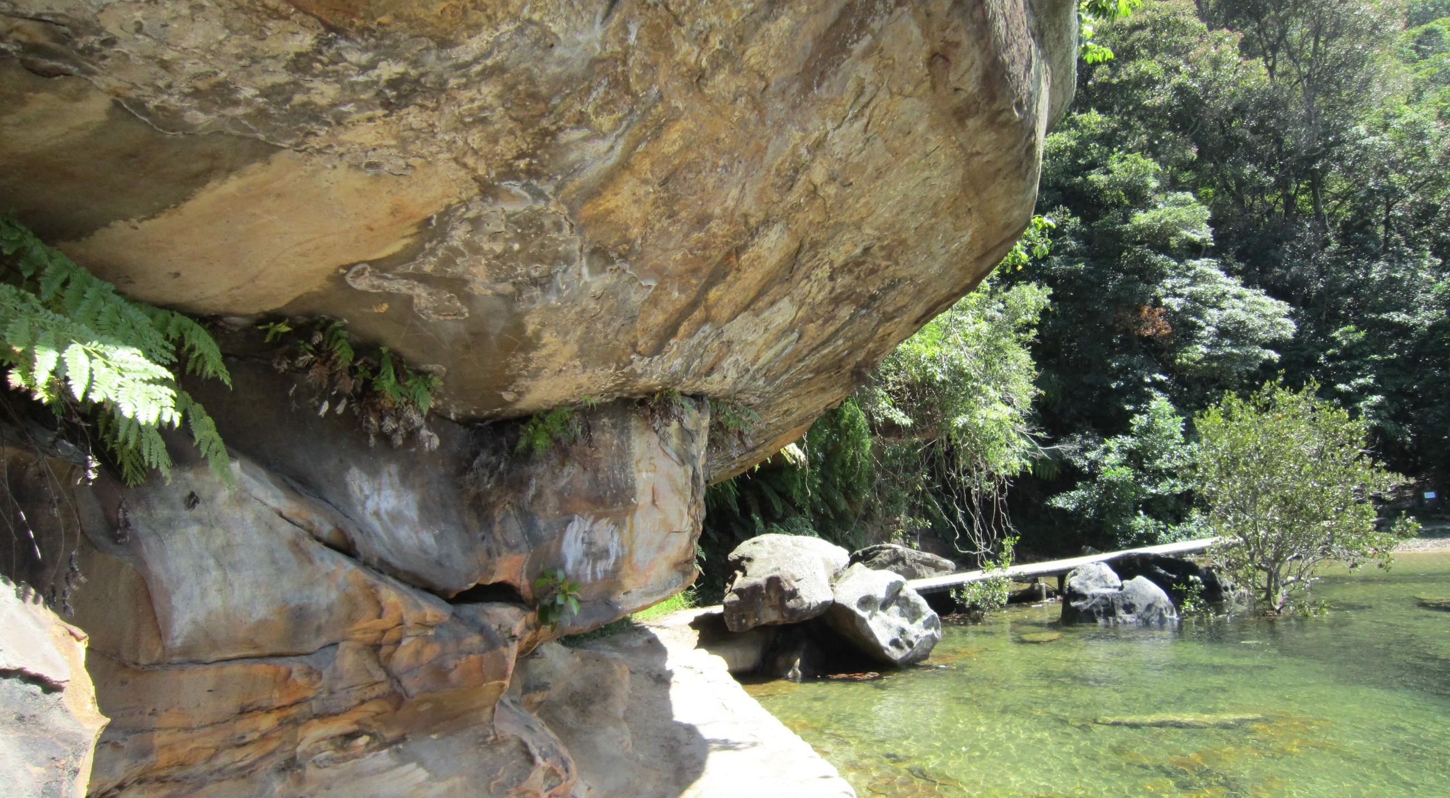
Possible Aboriginal rock shelter at Fisher Bay
A shell midden is nearby.

Slide 10
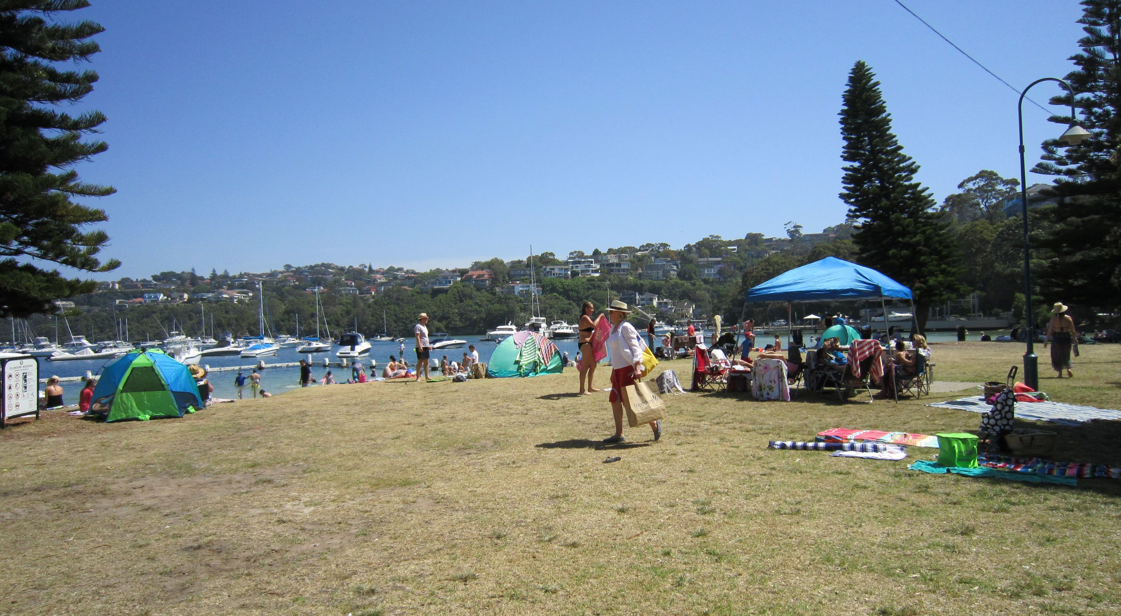
Clontarf
Named after a Dublin suburb, Clontarf was the site of an early Sydney picnic ground and dance hall. Prince Alfred, Duke of Edinburgh, survived an assassination attempt here in 1868.

Slide 11
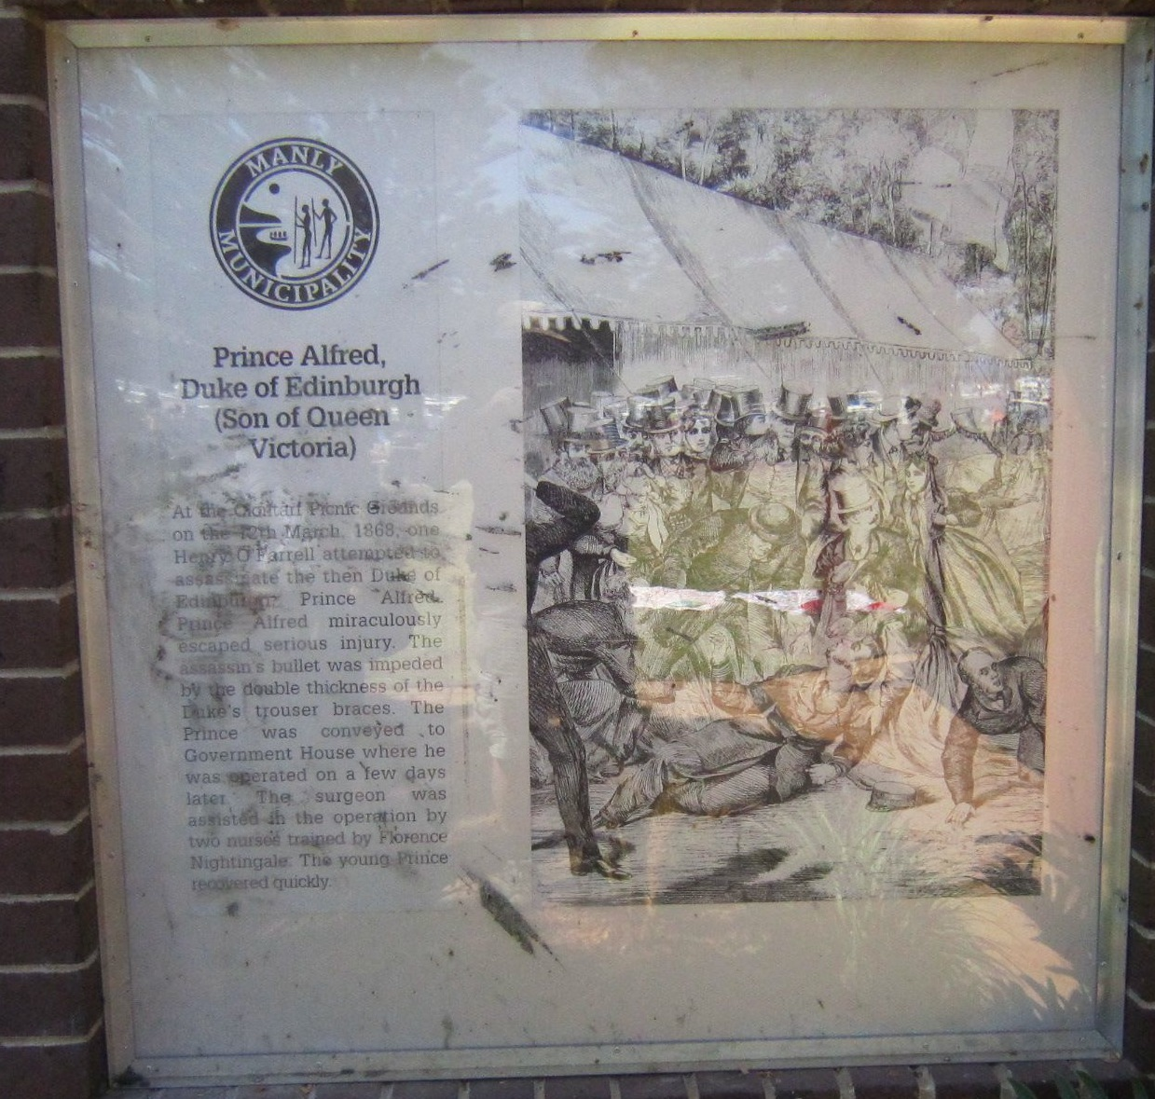
Sign at Clontarf

Slide 12
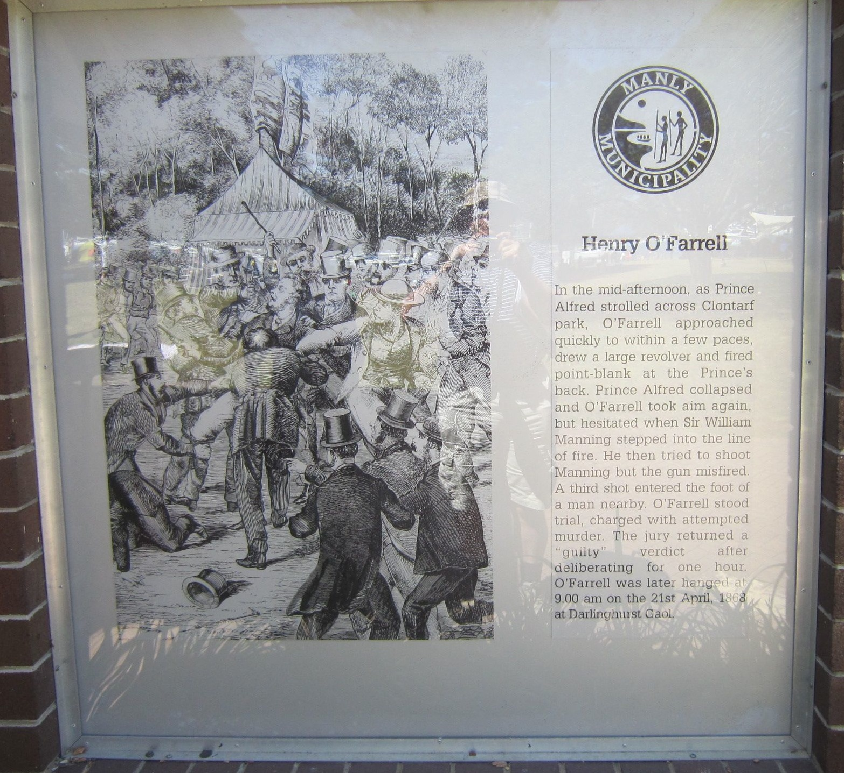
Sign at Clontarf

Slide 13
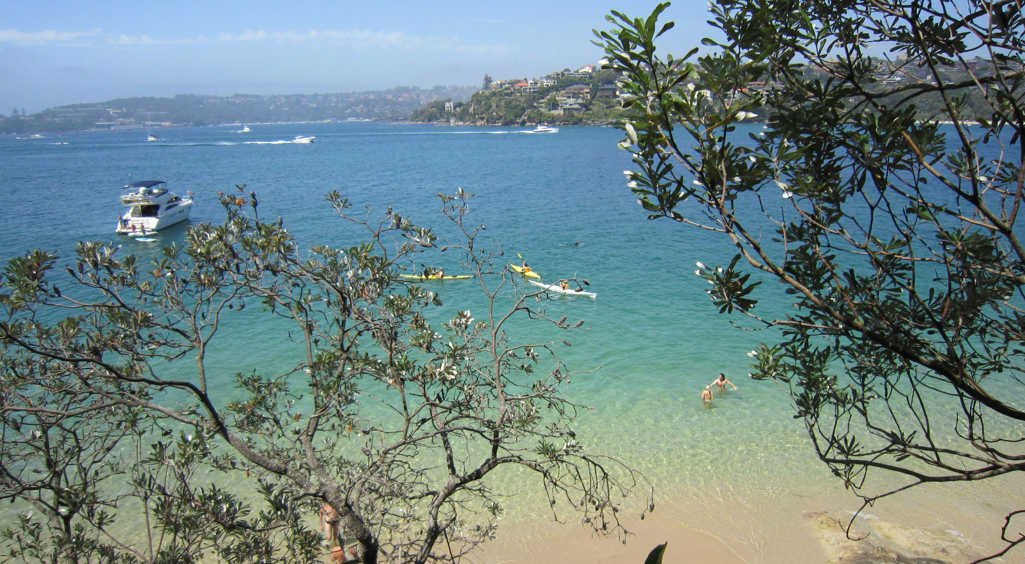
Middle Harbour near Clontarf

Slide 14
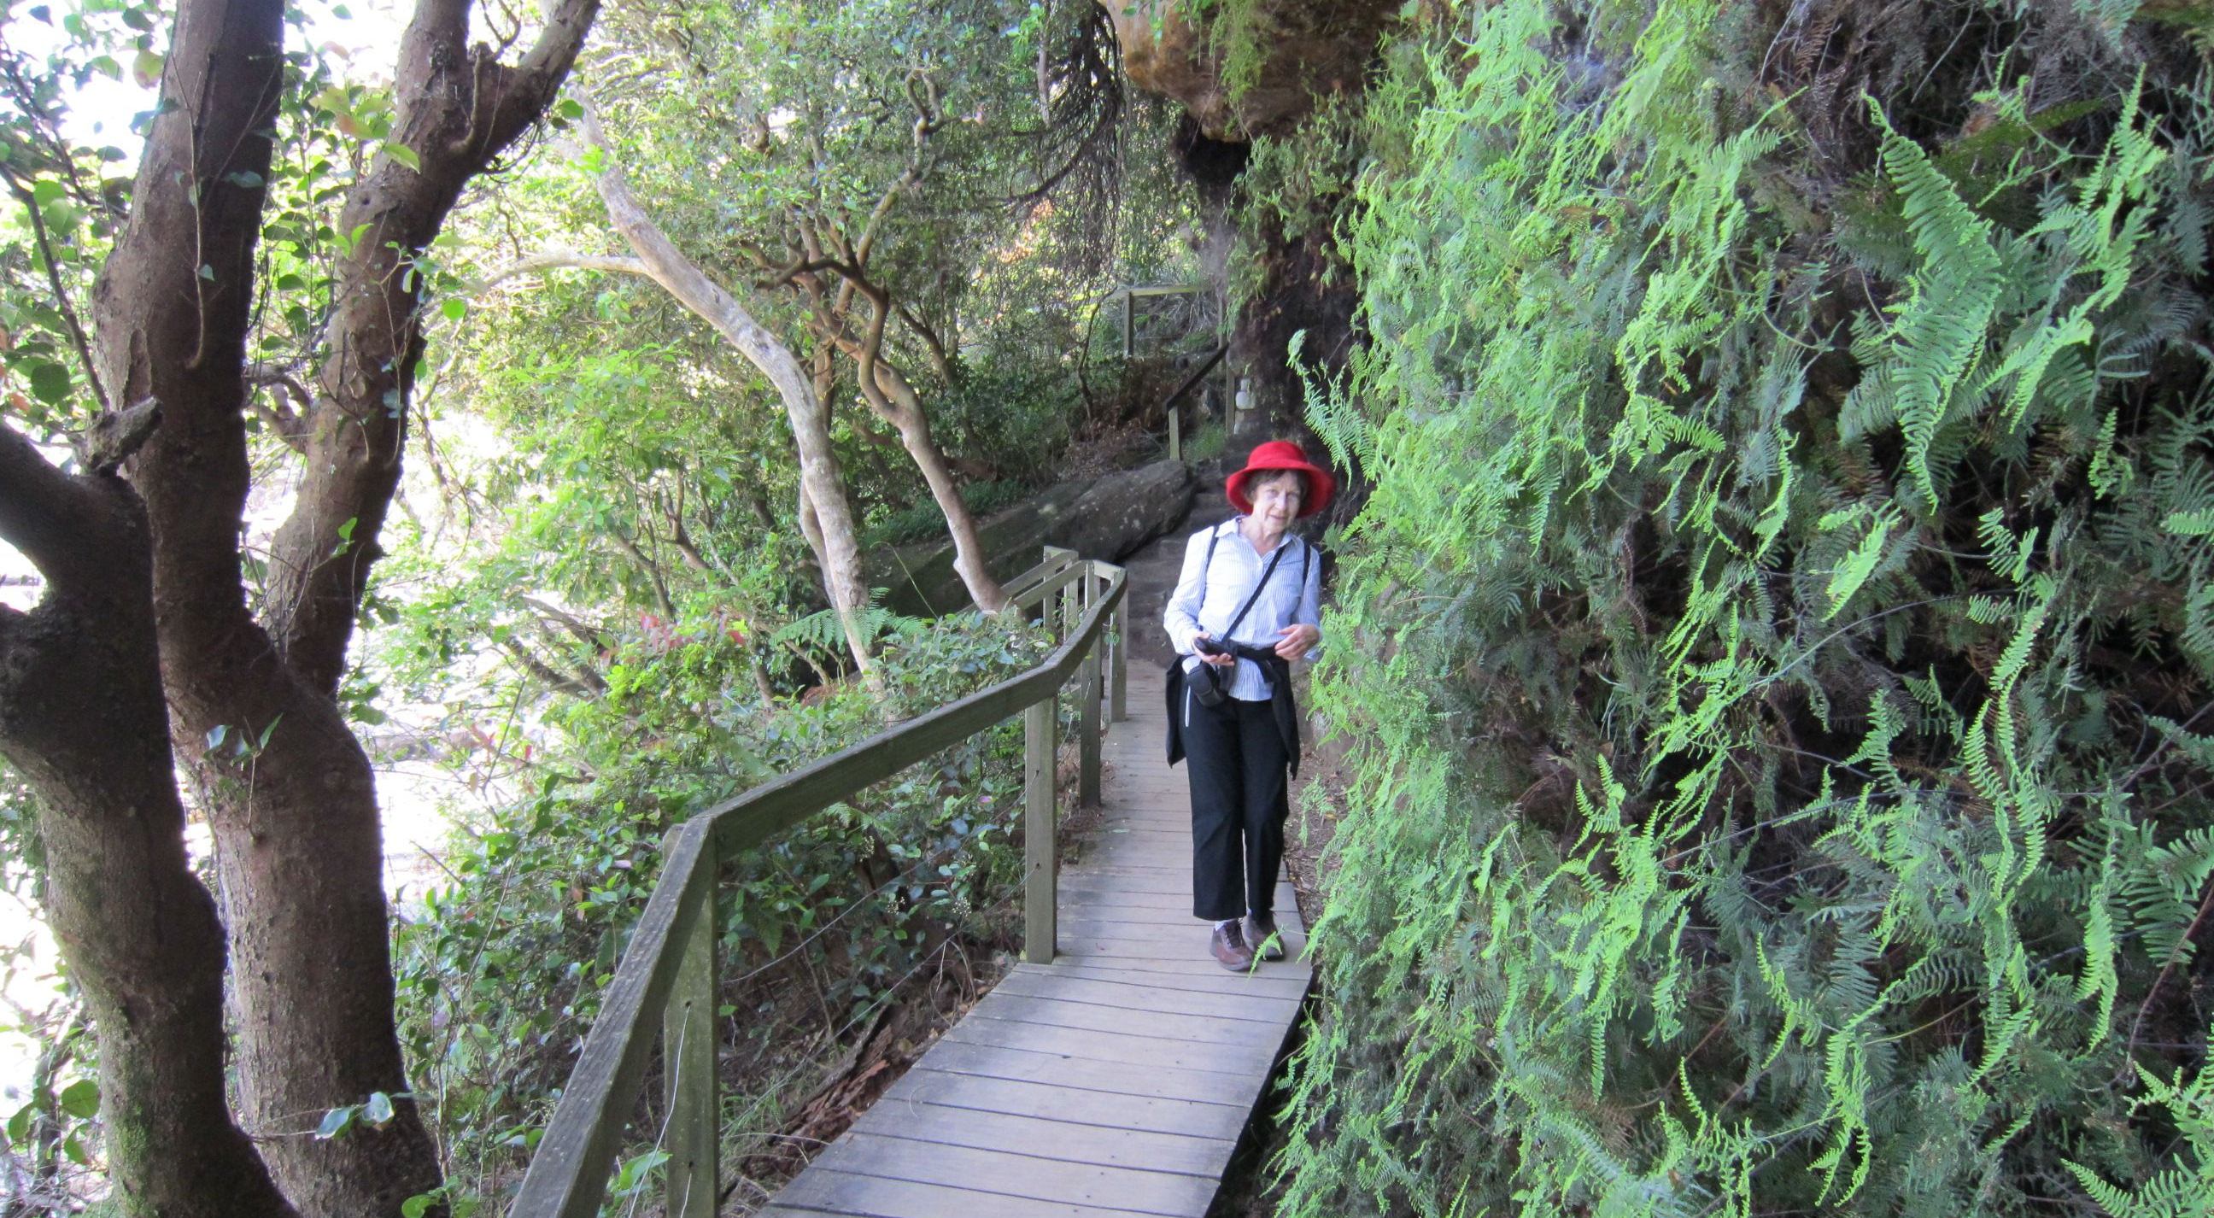
Between Clontarf and Grotto Point

Slide 15
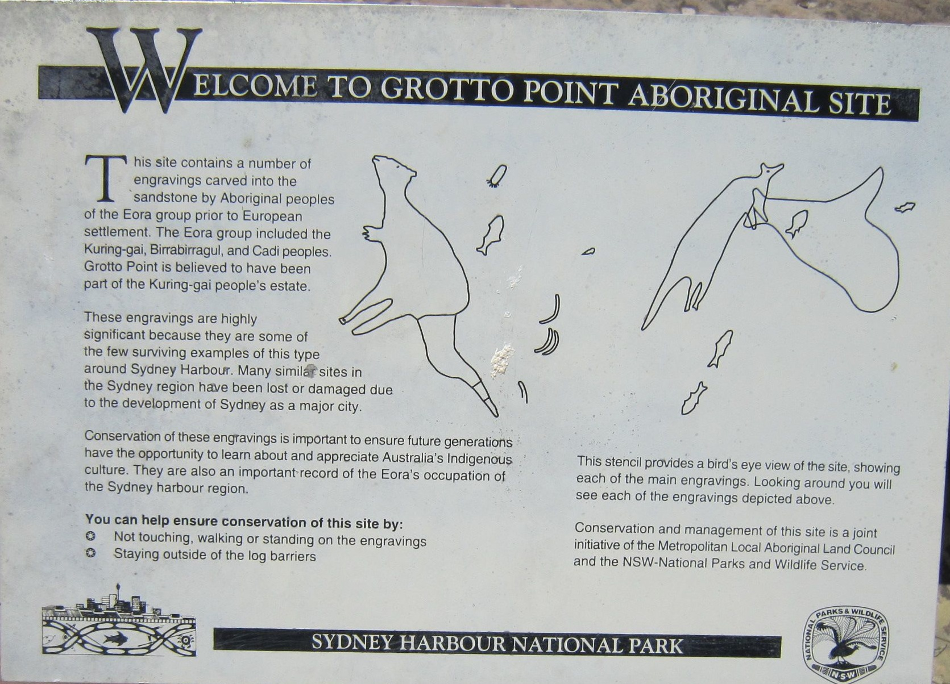
Grotto Point Aboriginal engraving site

Slide 16
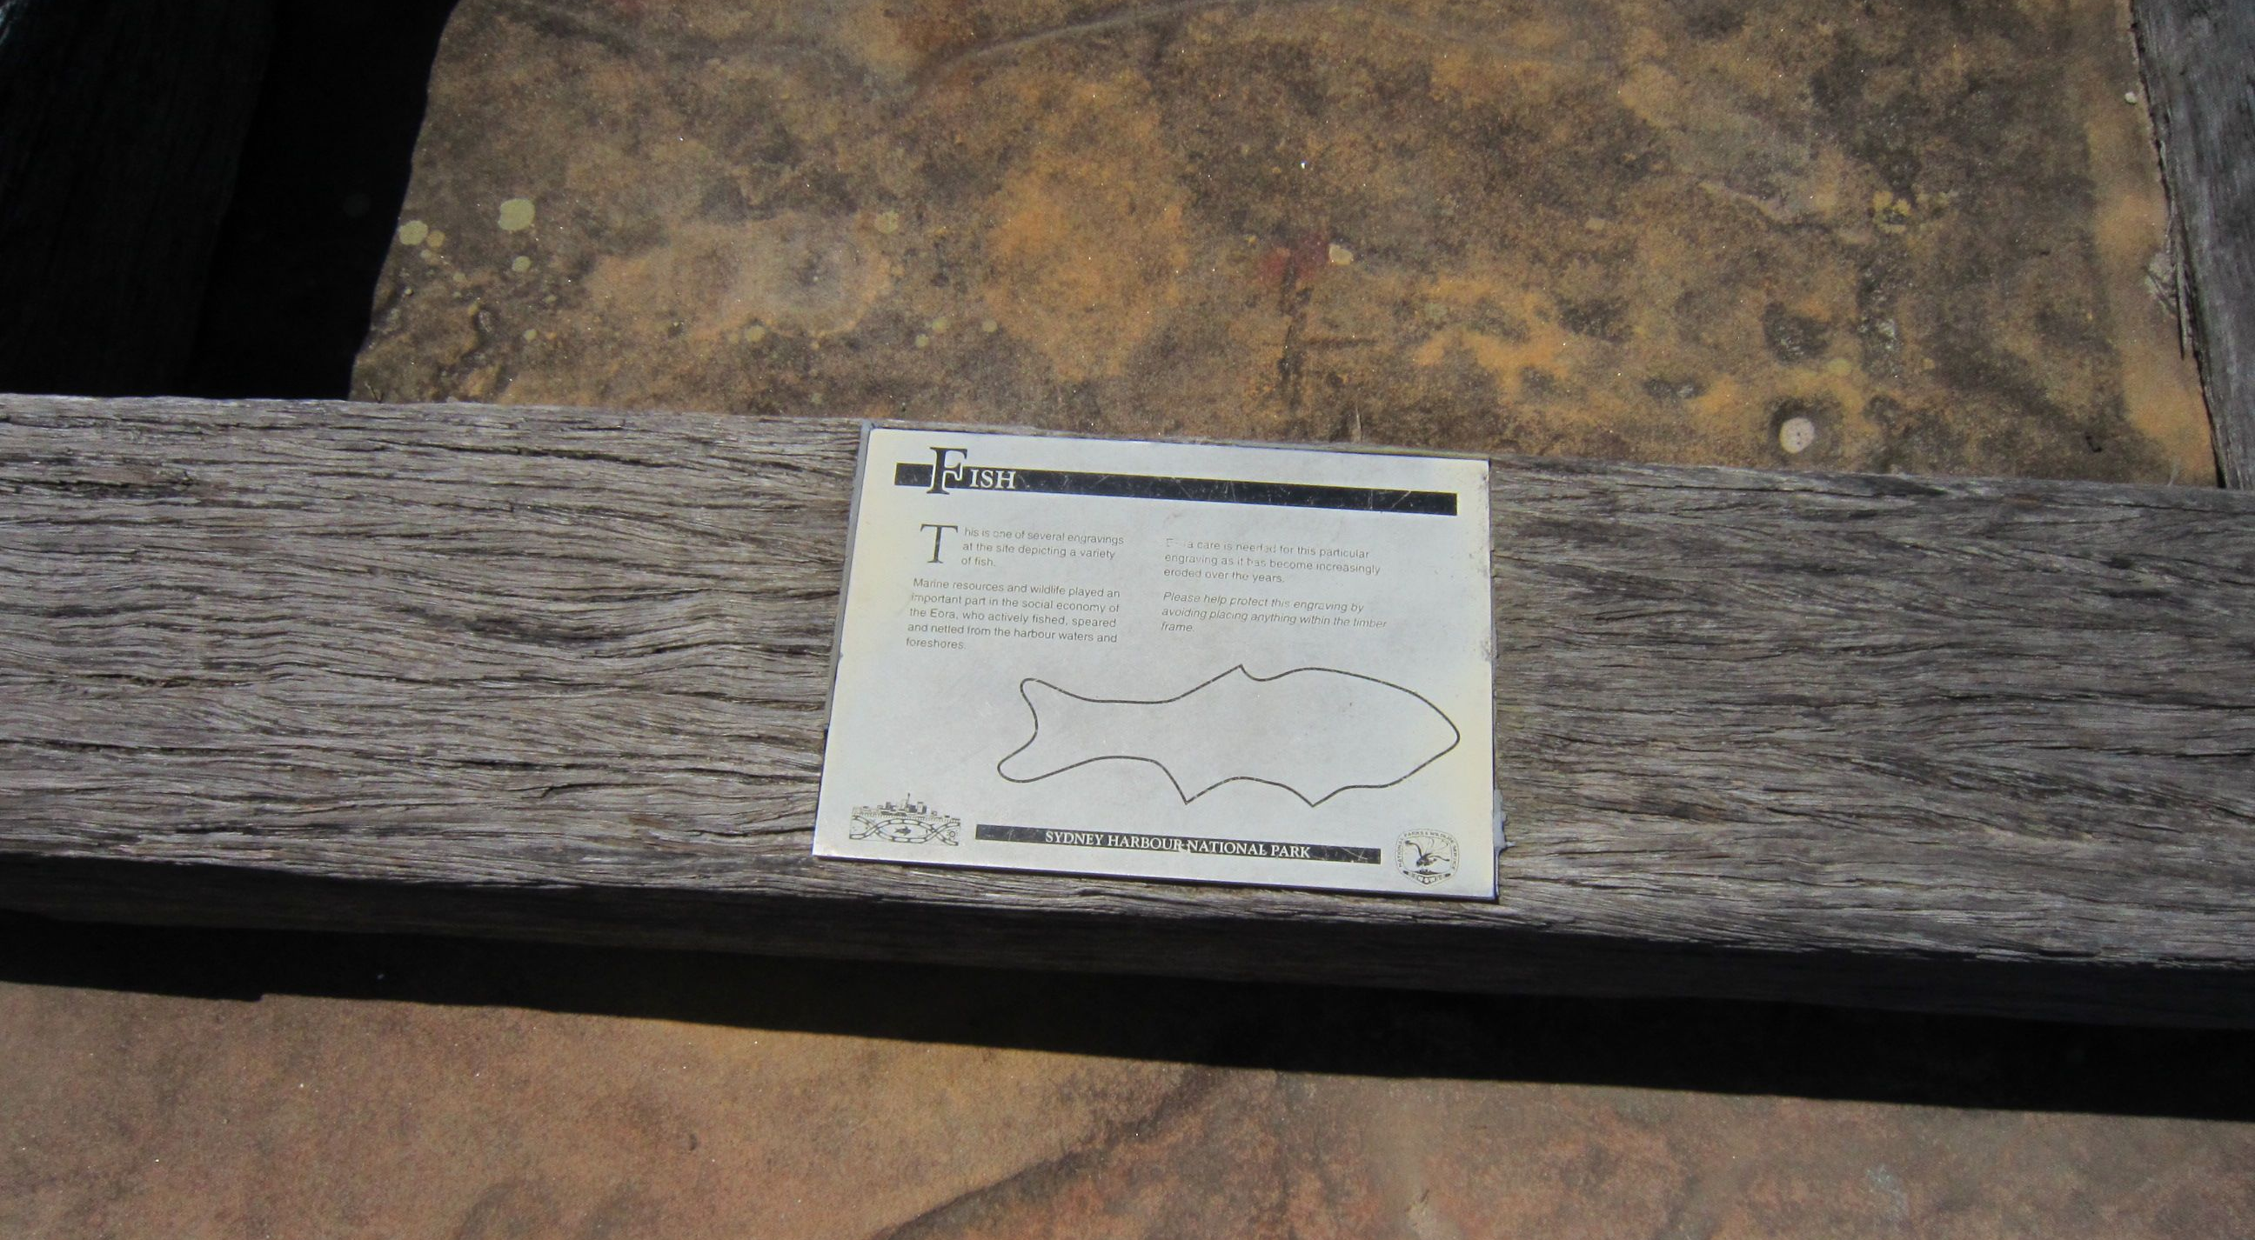
Grotto Point Aboriginal engraving site

Slide 17
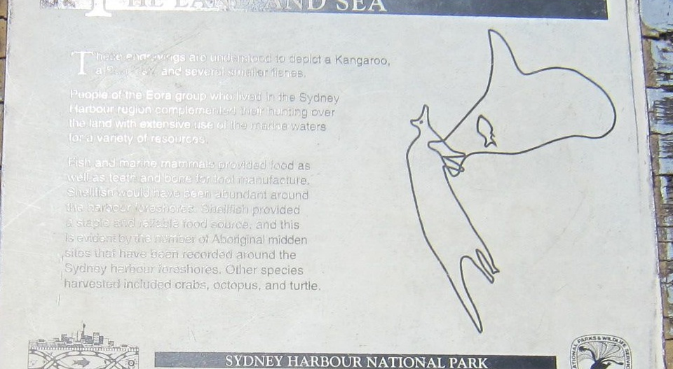
Grotto Point Aboriginal engraving site

Slide 18
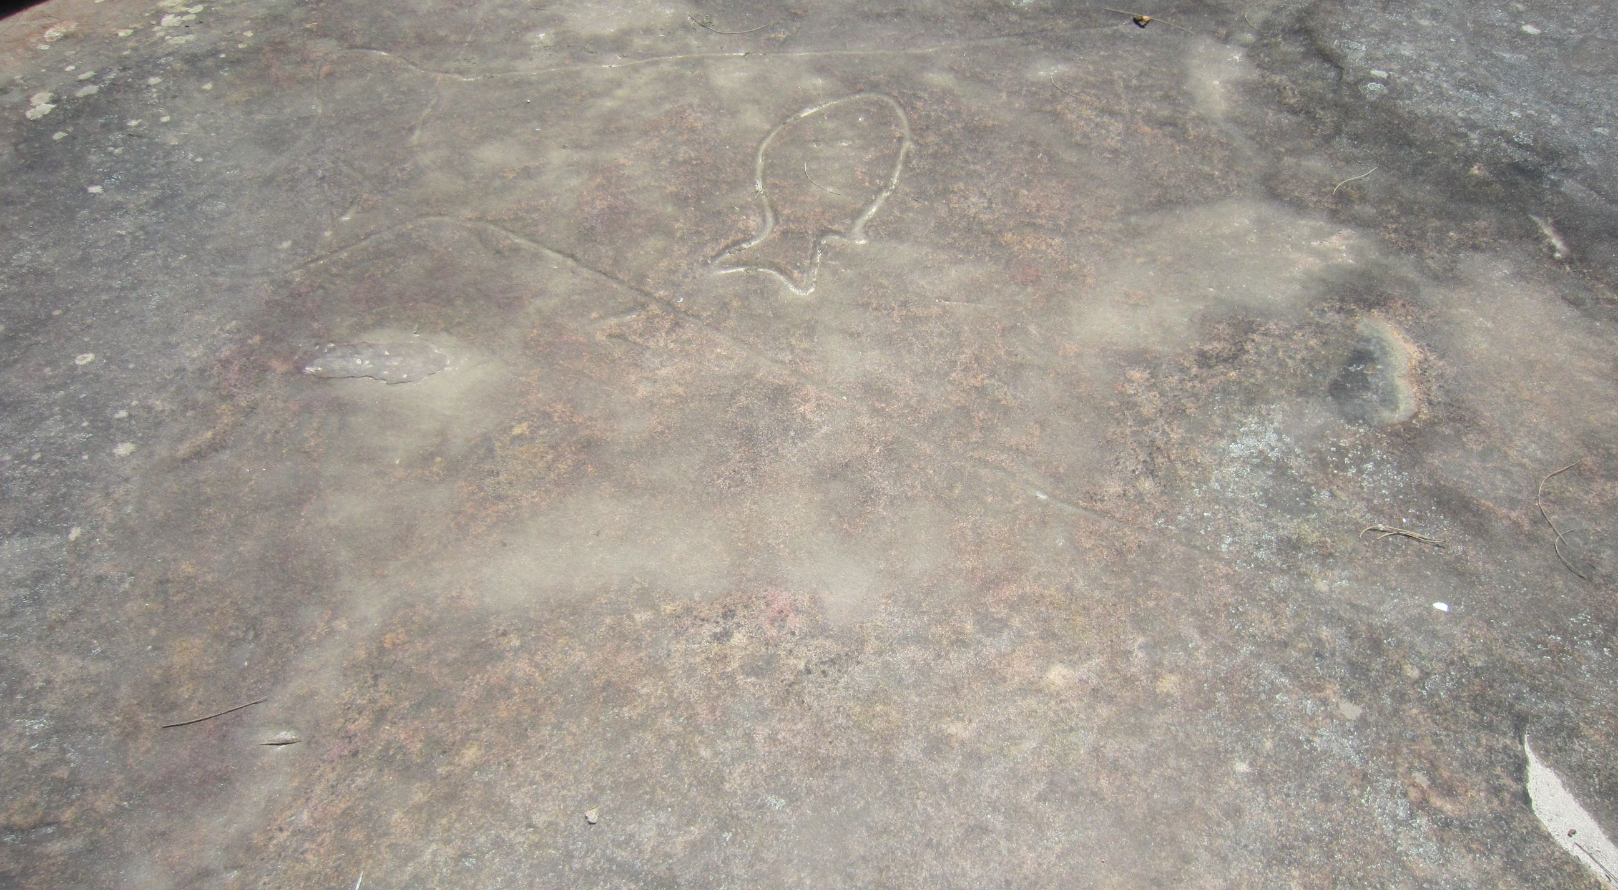
Grotto Point Aboriginal engraving site

Slide 19
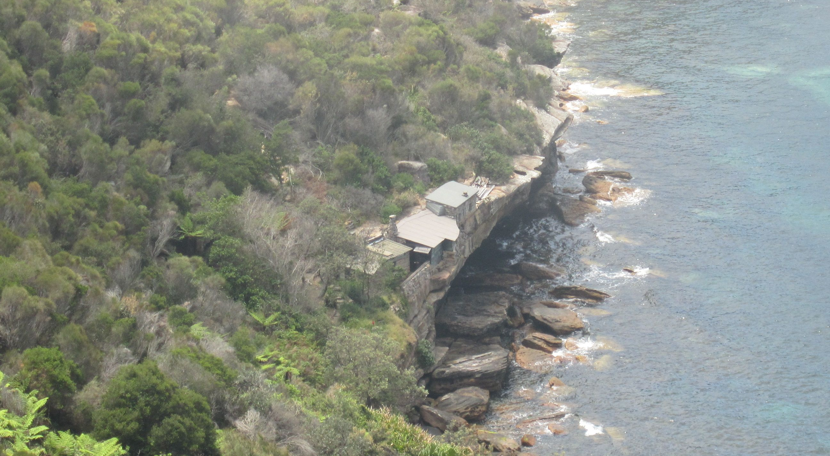
Crater Cove
The huts were built between 1923 and 1963.

Slide 20
Crater Cove look-out

Slide 21
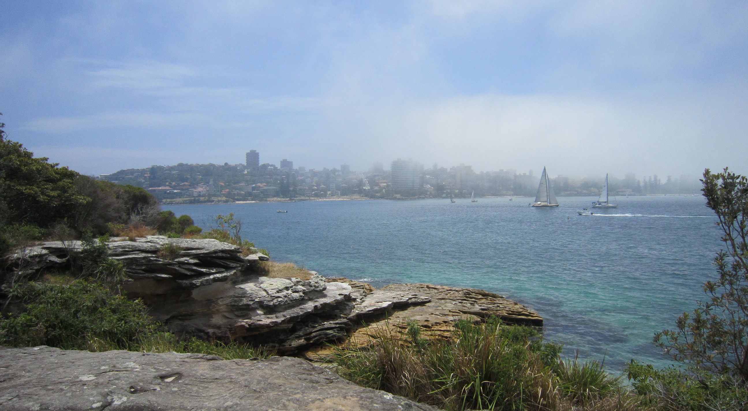
Looking towards Manly from near Dobroyd Head

Slide 22
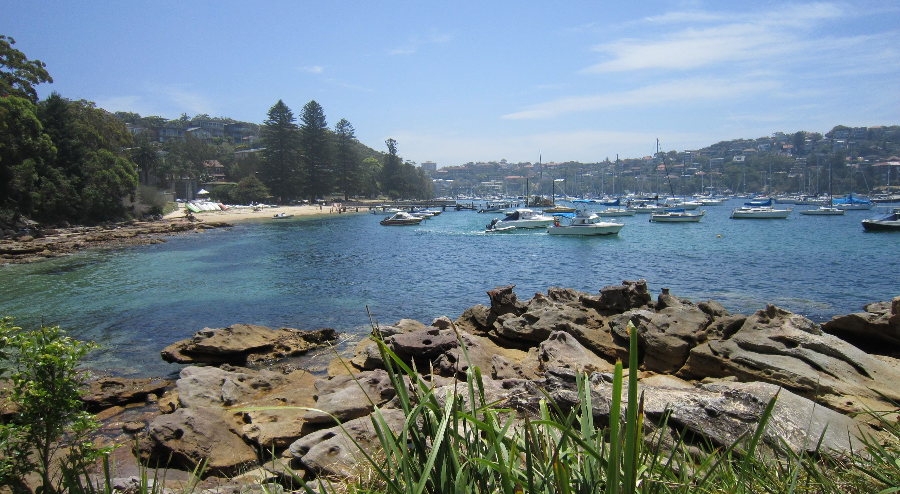
Looking towards Forty Baskets Beach from near Reef Beach
There was a camp at Reef Beach during the 1930s Depression. Forty Baskets Beach was named for a catch of fish sent to a contingent of troops returning from the Sudan interned at the North Head Quarantine Station in 1885.

Slide 23
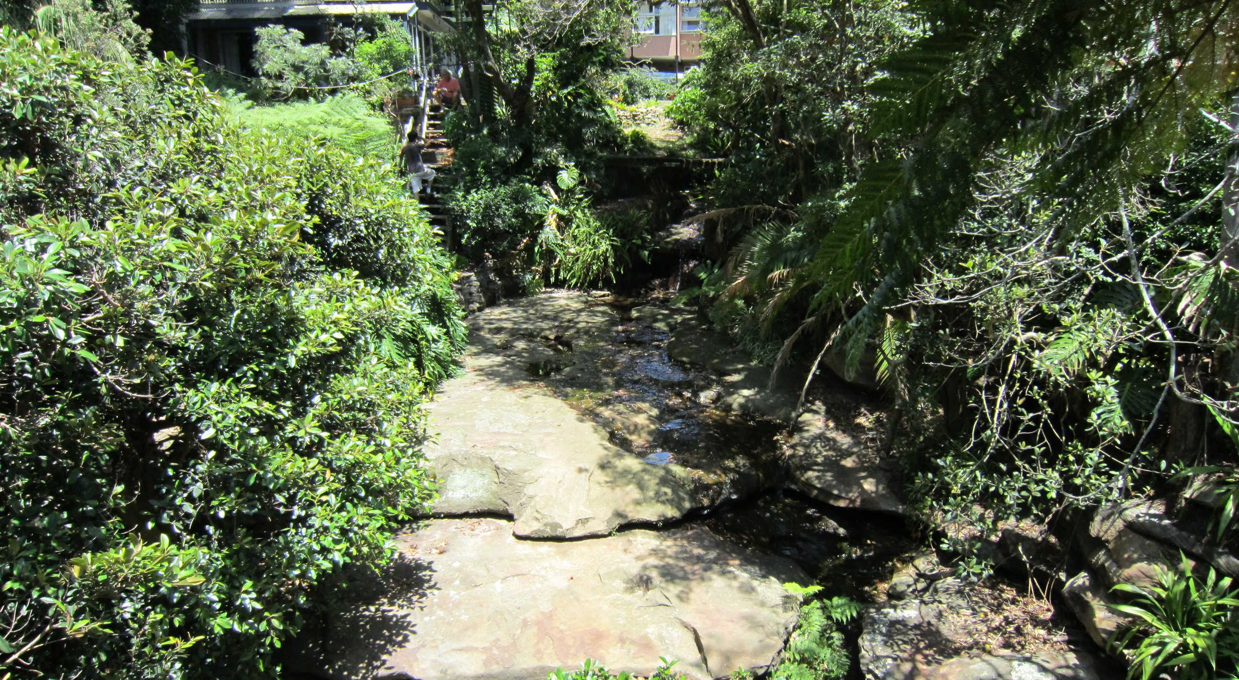
Wellings Reserve
Named after Leslie Wellings, a noted local historian and Town Clerk of Manly.

Slide 24
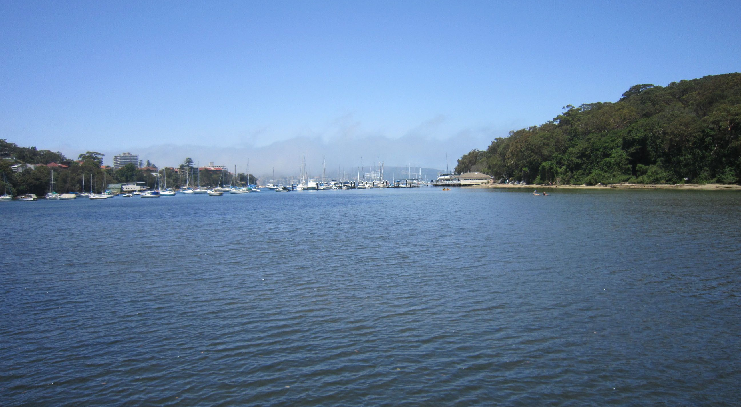
North Harbour
This inlet was the original area to be called ‘Manly’: Governor Phillip used the name in honour of the manly behaviour of local Aboriginal men.

Slide 25
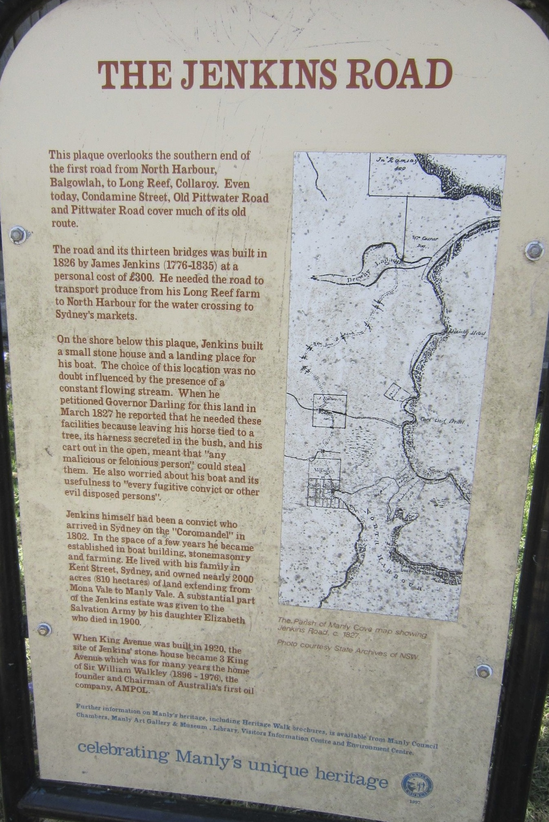
The Jenkins Road sign near North Harbour

Slide 26
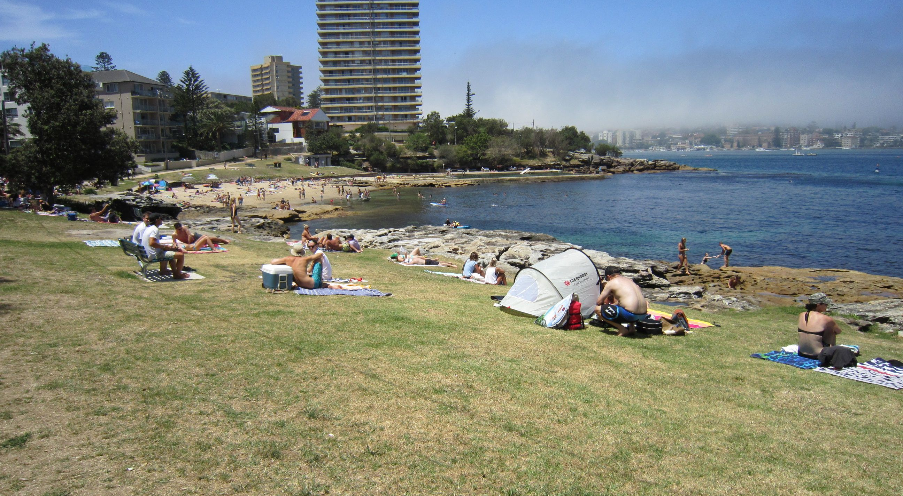
Fairlight Beach
Fairlight was named for a Georgian mansion that stood above the beach, the home of Henry Gilbert Smith (1802-1886), the entrepreneur regarded as Manly’s real founder.

Slide 27
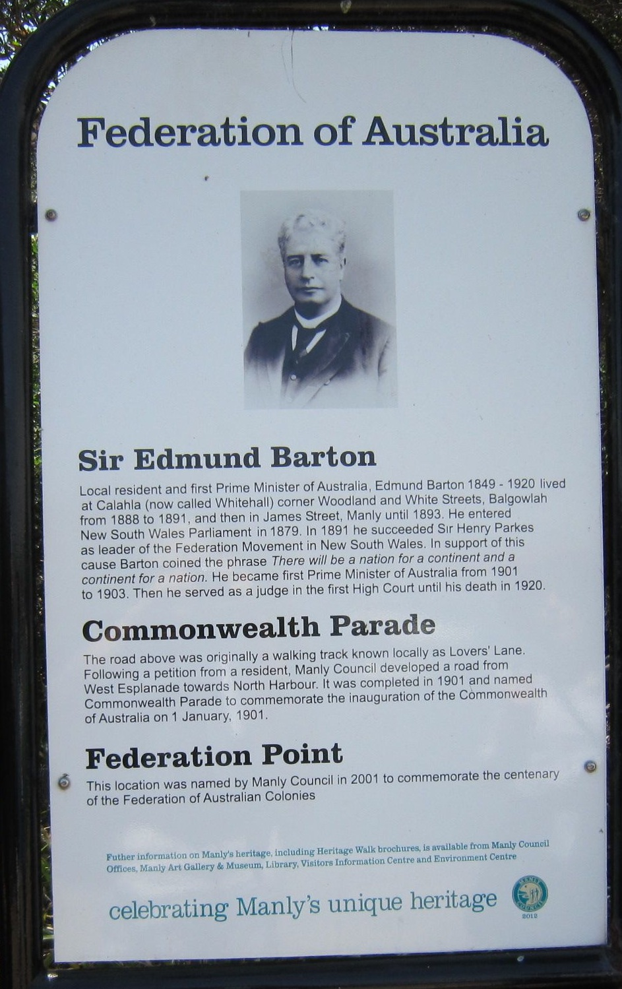
Sign at Federation Point

Slide 28
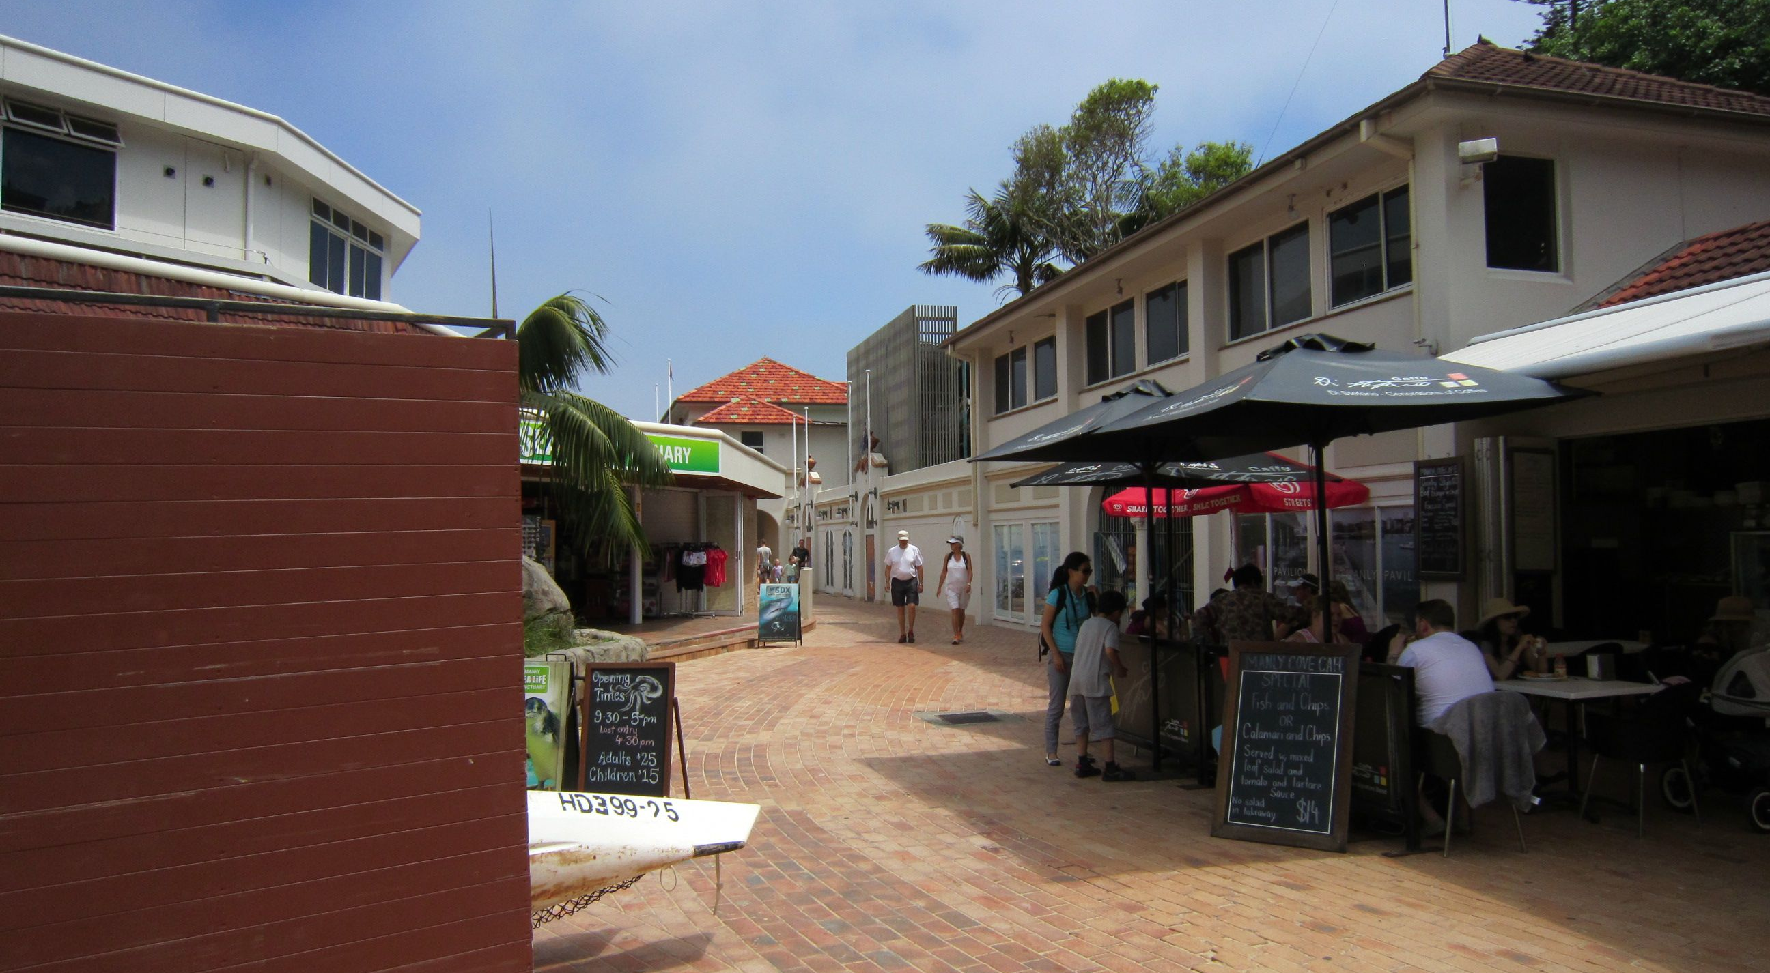
Manly Pavilion
Now a restaurant and café, the Spanish-style dressing pavilion was constructed in 1933.

Slide 29
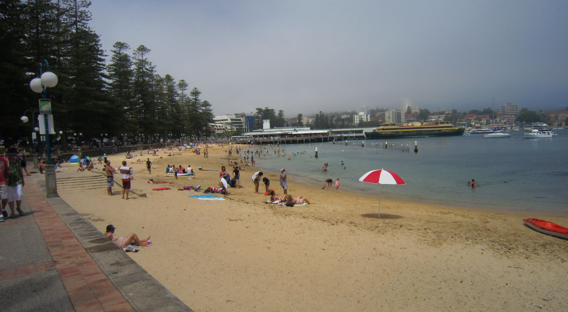
Manly Cove
H.G. Smith established the ferry service in 1854. Manly became a popular day excursion, ‘seven miles from Sydney and a thousand miles from care’. The wharf was reconstructed in 1903 with a promenade. The swimming enclosure was much bigger until 1978, when storm damage resulted in it being reduced in size.

Slide 30
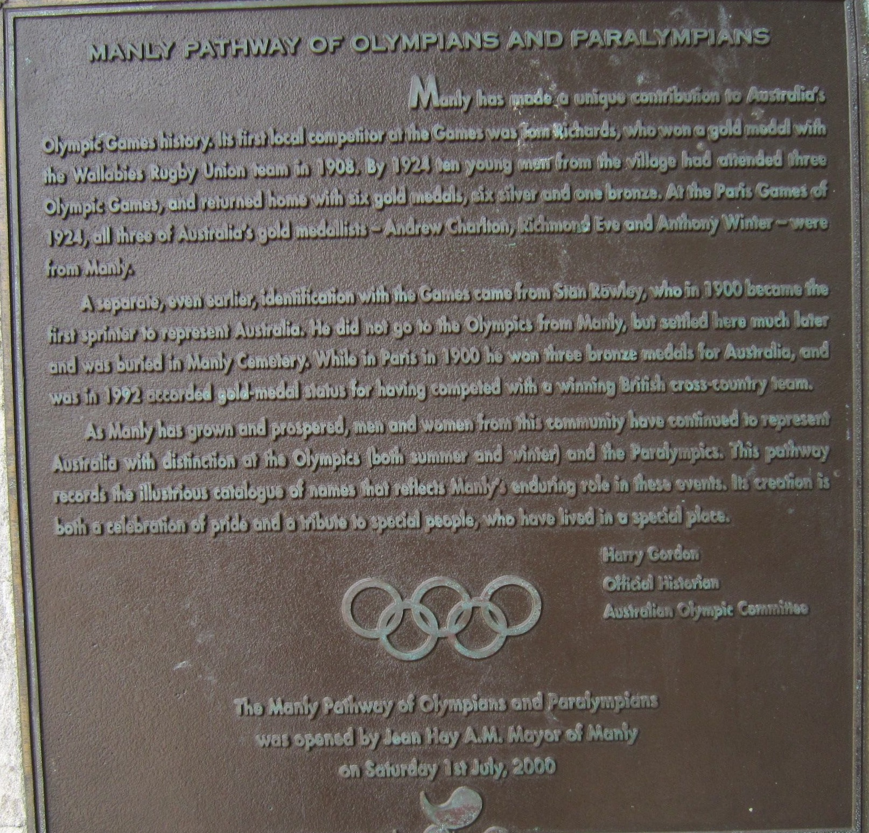
Plaque near Manly Wharf

Slide 31
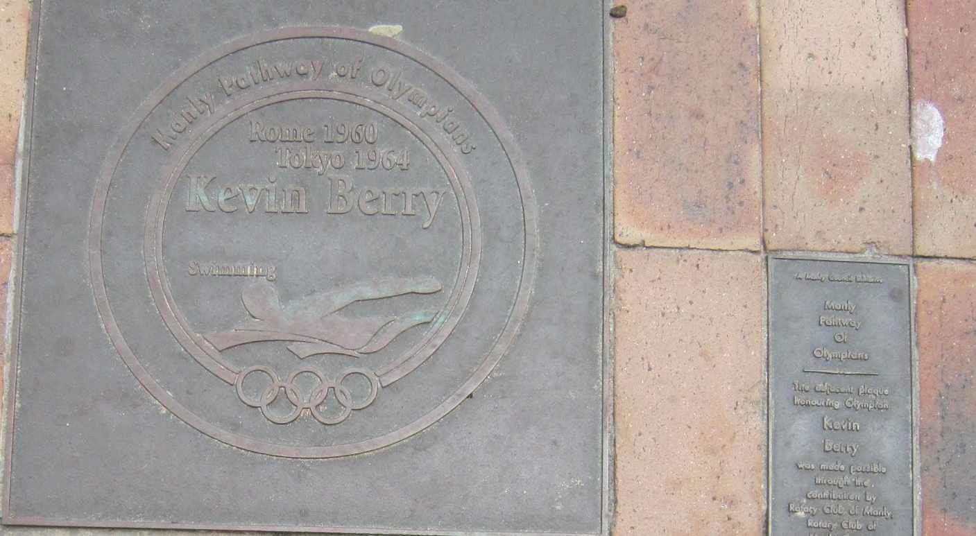
Plaque near Manly Wharf

Slide 32
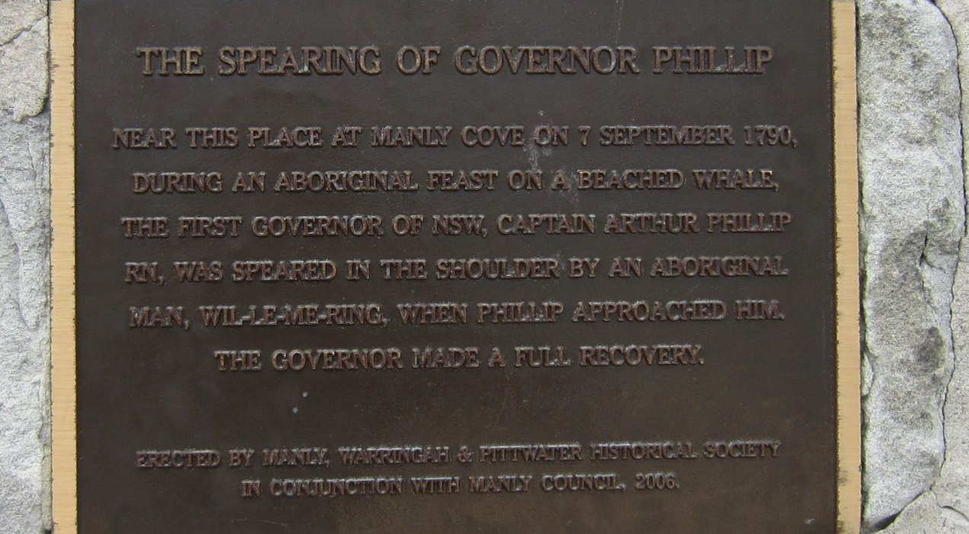
Plaque near Manly Wharf

Slide 33
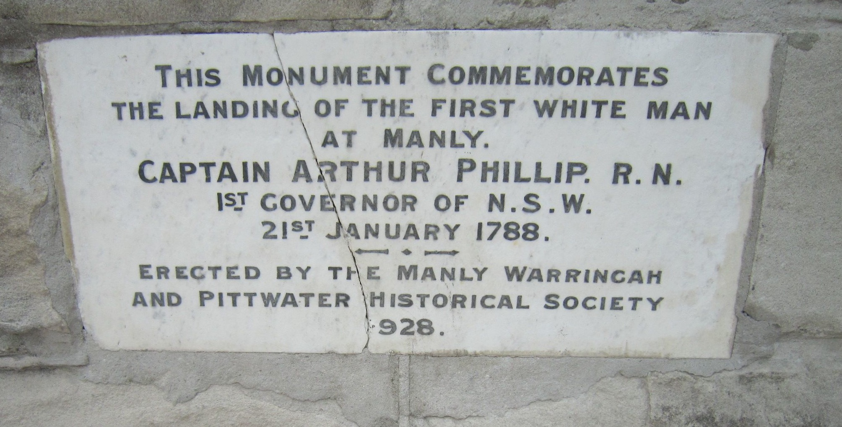
Monument near Manly Wharf

Slide 34
For further information
Melinda Hinkson & Alana Harris, Aboriginal Sydney, Second Edition, Aboriginal Studies Press, Canberra, 2010, sites 12-14.
Graham Spindler, Detailed Maps and Background Notes for the Harbour Bridge to Manly via The Spit Walk, Part 3: The Spit Bridge to Manly, 2012, www.walkingcoastalsydney.com.au/brochures/documents/harbourbridgetomanlyandthespitpartthree.pdf
The Spit: Historical Overview, Local Studies Service Mosman Library, Mosman, no publication date.

